Slide 1
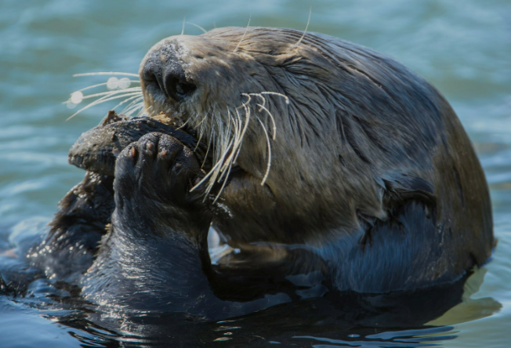

Welcome to Otter Class
2026-2027

Slide 2
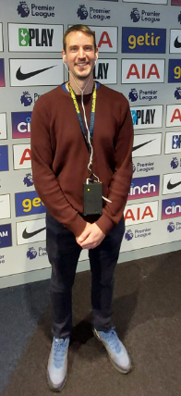
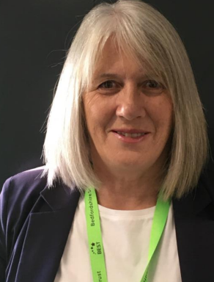
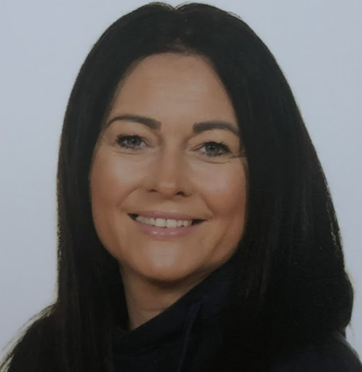
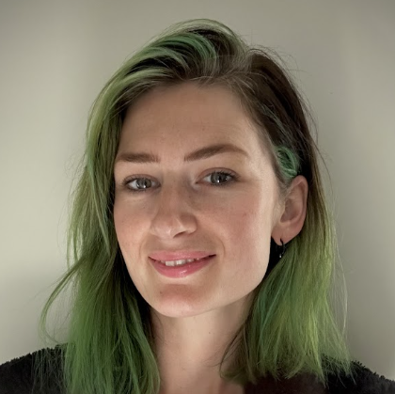
Who is in in our class?
Mr Gotham
Class Teacher
Ms Devereux
Advanced TA
Mrs Fleming
LSA
Mrs Green
LSA

Slide 3
A bit about me:
Hello, my name is Mr Gotham and I am the Assistant Principal here at Langford and Year 6 class teacher. I am so excited to be your class teacher in Otter Class and get to know you better. In the meantime, let me tell you a few things about me.
I was born in London and graduated from the University of Hull. Upon graduating, I went travelling around the world, from Europe to Africa, Australia, New Zealand and finally to South East Asia. It was on my travels that I discovered my love for teaching (I taught in Vietnam).
My wife, Krishna, and I have been together for 11 years and have three wonderful children, Sirenna, aged 9, and Gabriel, aged 6, and Lilliana, who just turned 2. We enjoy runs in the woods with our over-energetic dog, playing table tennis and watching football.
I have previously taught in a range of educational settings, including primaries, lowers, middle and secondary schools in London, Bedford and now in Langford.

Slide 4
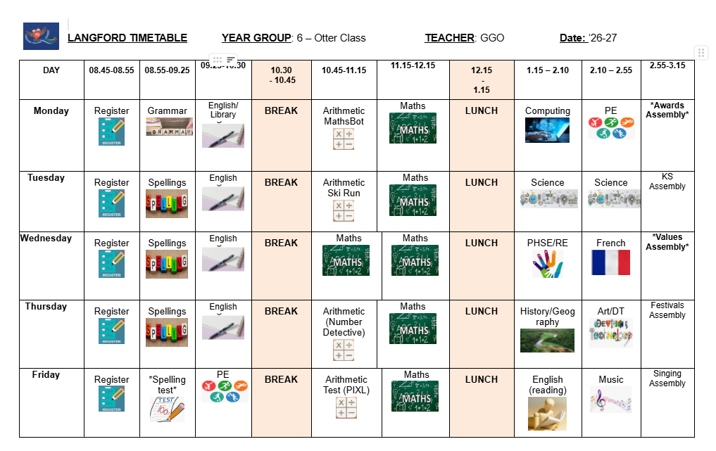
Our Timetable:
Notes:
Instead of having

Slide 5
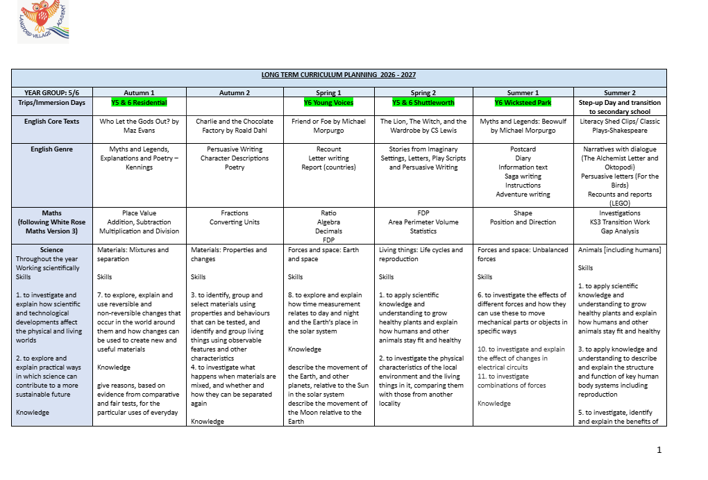
Curriculum overview:

Slide 6
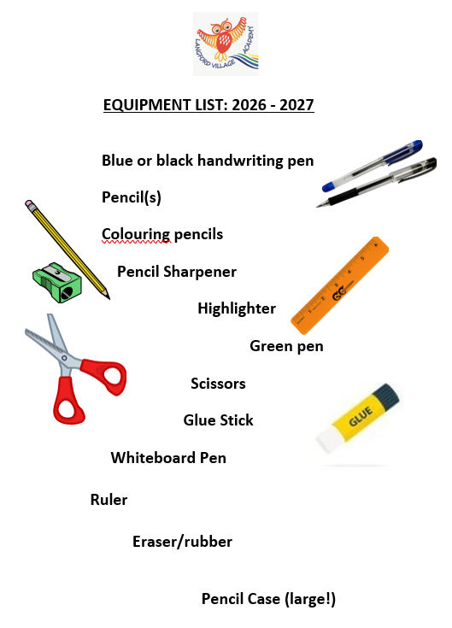
Equipment List:
In Year 6, our expectations are that the pupils bring in their equipment every day. This includes the items of stationery opposite as well as their reading books and any PE wear they may need.
House points are awarded for correct equipment each week! ☺

Slide 7
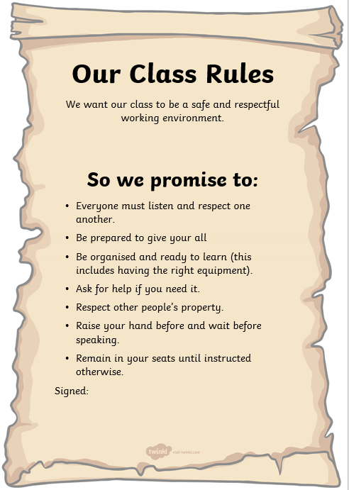
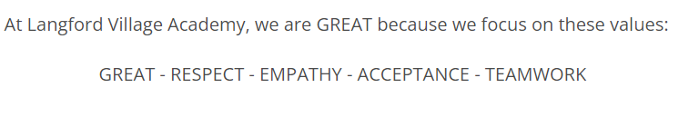
Our Class Promise:
In Otter Class, we promise to be G.R.E.A.T and live by our school, and class rules. This means trying our best and respect each other.

Slide 8
Home Announcements:
Year 6 timetable:
Otter Class PE: Wednesday and Friday
Reminders:
-Reading Books are changed on Monday
-Reading books must be brought into school every day
-English and maths homework is set at the end of the week (Friday) and is due the following Wednesday
-Spelling test day: Friday (this is set on Mondays)
*Each Y6 child has been given a BEST email address, which they can use to login Google Classroom. This is where our Y6s will continue their educational journey throughout the year. All the week’s work, along with the spellings and homework will be posted on Google Classroom at the end of every week.*

Slide 9
Parent Links:
English:
Pobble 365
https://pobble.com/
Once upon a picture
Maths:
TTRS
https://ttrockstars.com/
Maths is Fun
https://www.mathsisfun.com/
Mathsframe
https://mathsframe.co.uk/
Science:
Science Fun
https://www.sciencefun.org/kidszone/experiments/
Other:
Go Noodle
https://www.gonoodle.com/
BBC Bitesize

Slide 10

Are there any questions?
If you have any questions please contact the school office or Mr Gotham.
My email address is ggotham@bestacaedmies.org.uk
We look forward to supporting your child with all of their learning!

