Slide 1
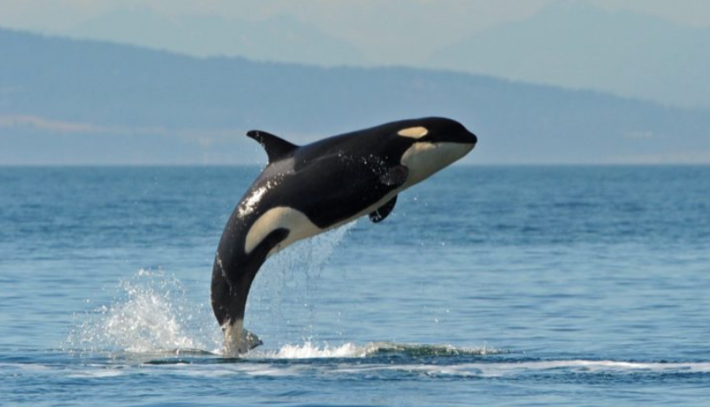

Welcome to
Orca Class
2026-2027

Slide 2
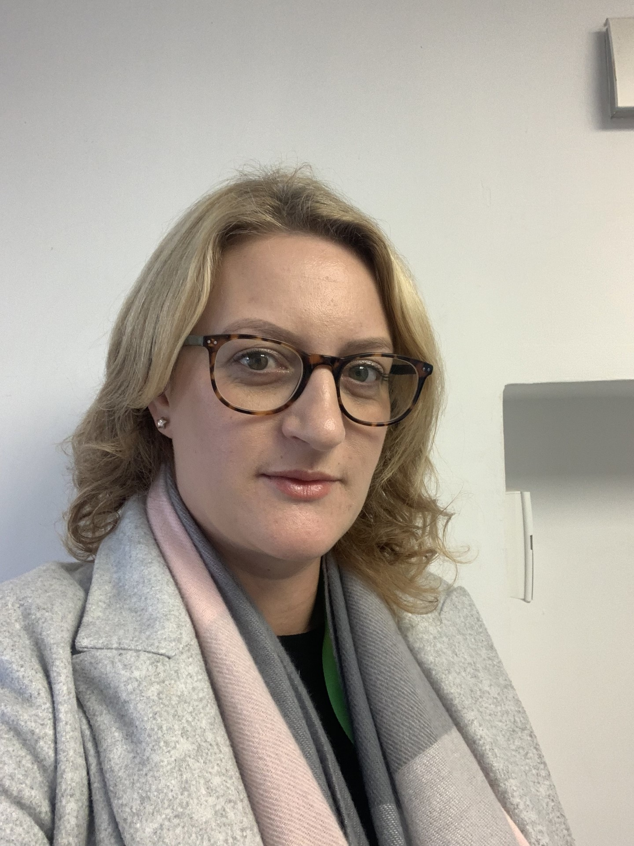
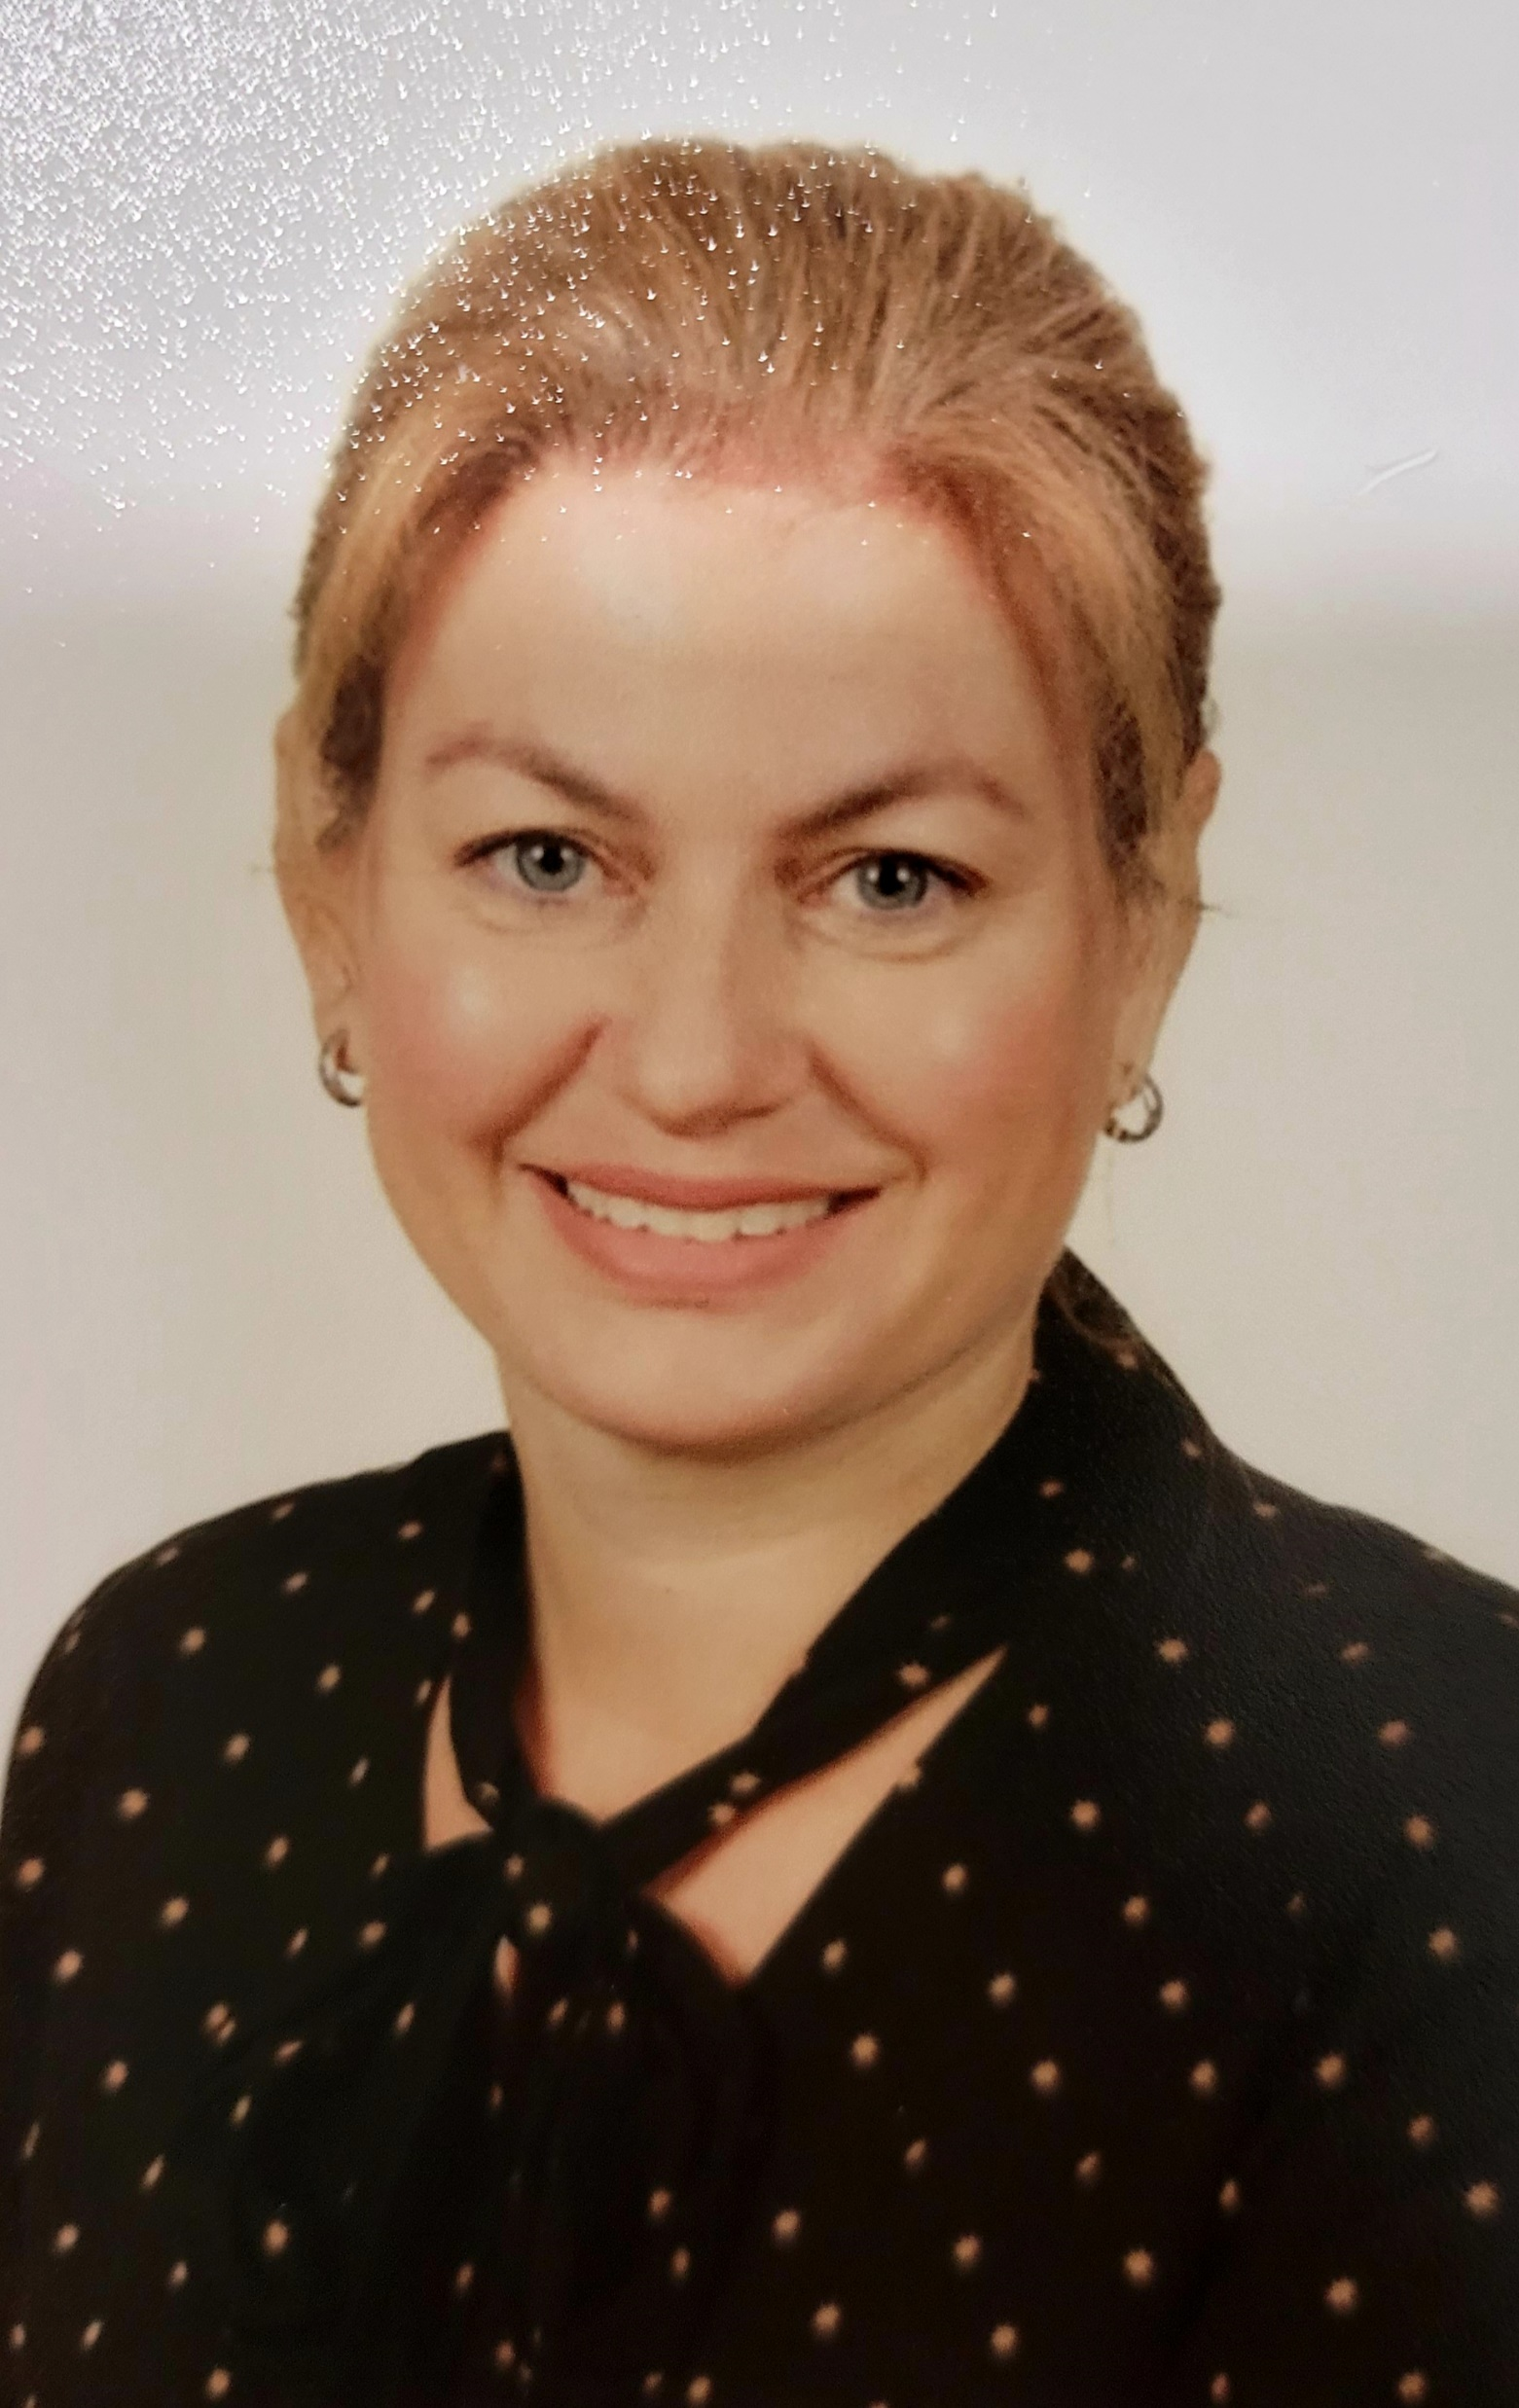
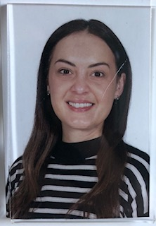
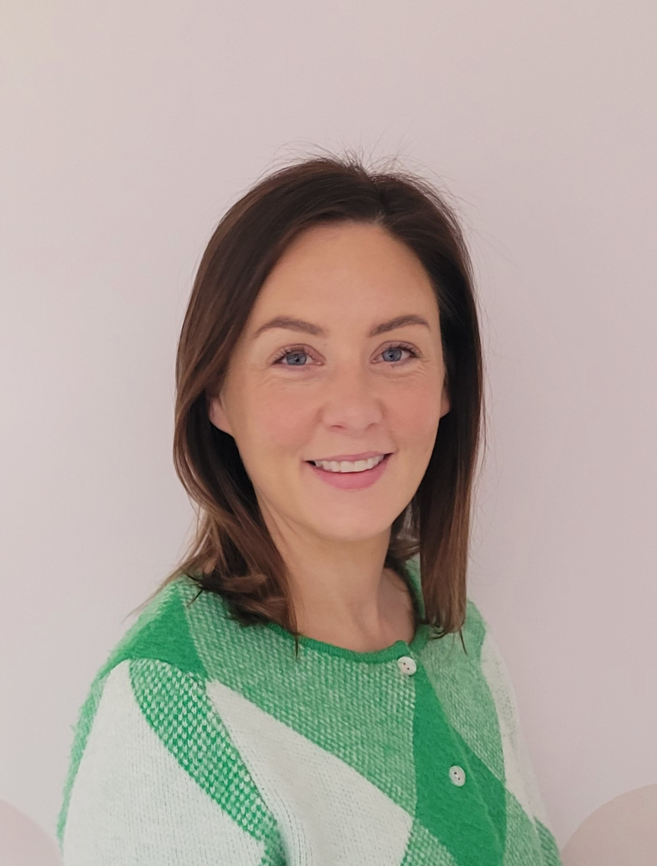
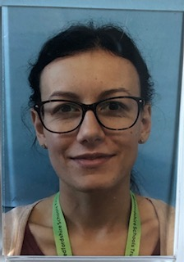
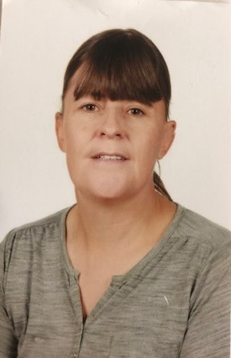
This is our team…
Mrs Rennie
Teaching Assistant Mon-Tues.
Mrs Ainsworth
Teacher
Mon, Wed, Thurs, Fri.
Miss Whitehead
Teaching Assistant
Wed - Fri.
Mrs A’Barrow
Teacher
Tues. am
Miss Rowlands
PPA Cover
Fri. pm
Mrs Jeffery
Teaching Cover
Tues pm

Slide 3
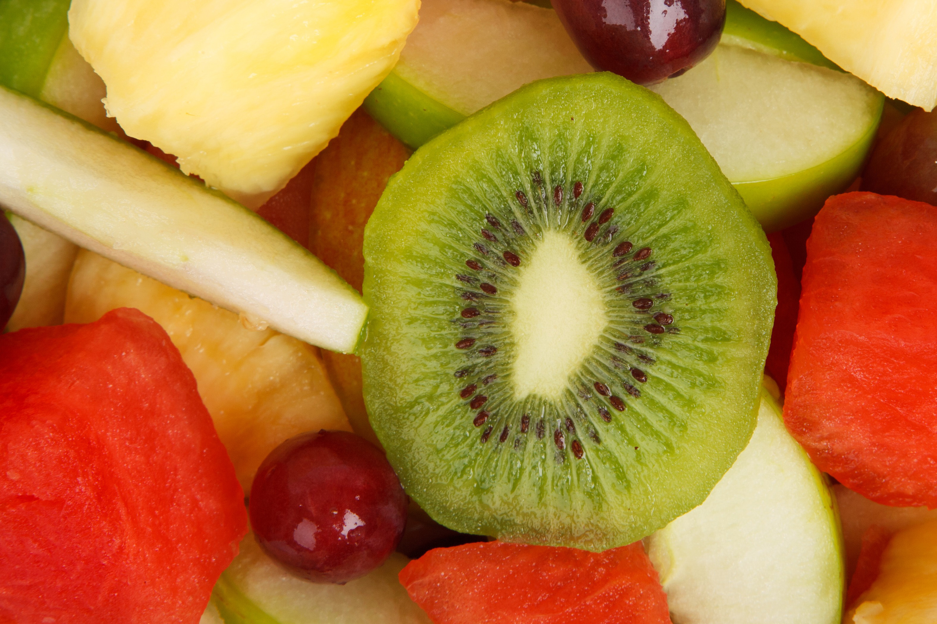
Morning Routine
Children should be dropped at the main gate at 8.45am where they will walk directly to their classroom, in time for registration at 8.55am.
Your child will need their book bag (reading books) and a labelled water bottle.
They can bring a fruit or vegetable snack for break time.

Slide 4
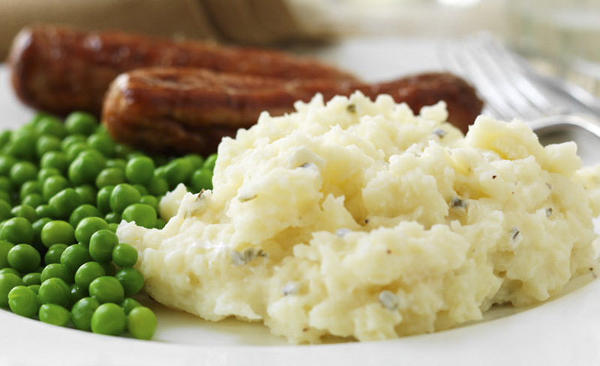
Lunchtime
Lunchtime begins at 12.15pm. Orca Class go outside to play until their class is called in for lunch. They then return to the playground until the end of lunchtime at 1.15pm.
The children return to their classroom for a drink before the afternoon session begins.

Slide 5

Afternoon Routine
The afternoon finishes with an assembly at 2.55.
The children are brought to the exit door at the far end of the playground to be collected by their parents.
Your child can be collected when the parent or carer can be clearly seen.
If someone else is collecting
your child please let the school office know.

Slide 6
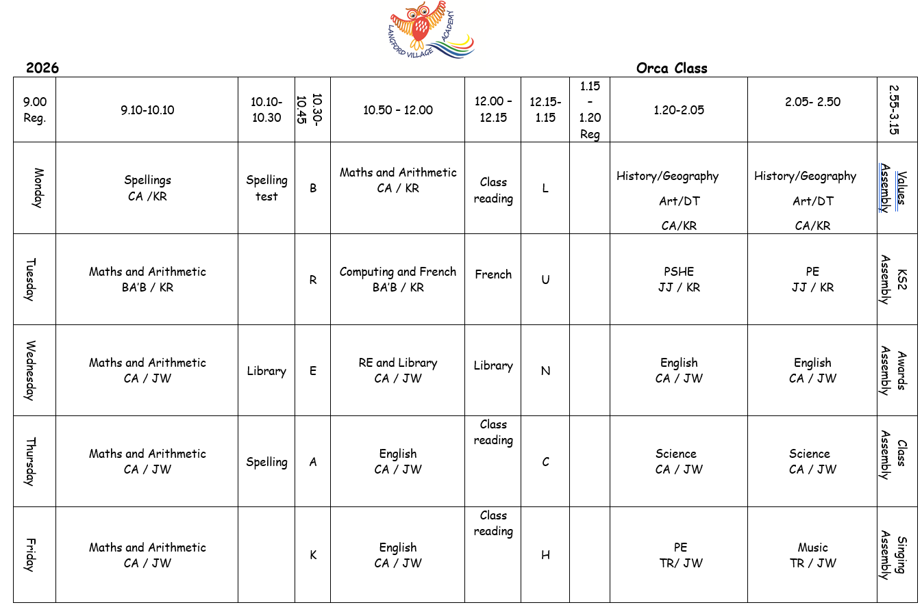
Class timetable
PE-Tuesday and Friday.
Library -Wednesday

Slide 7
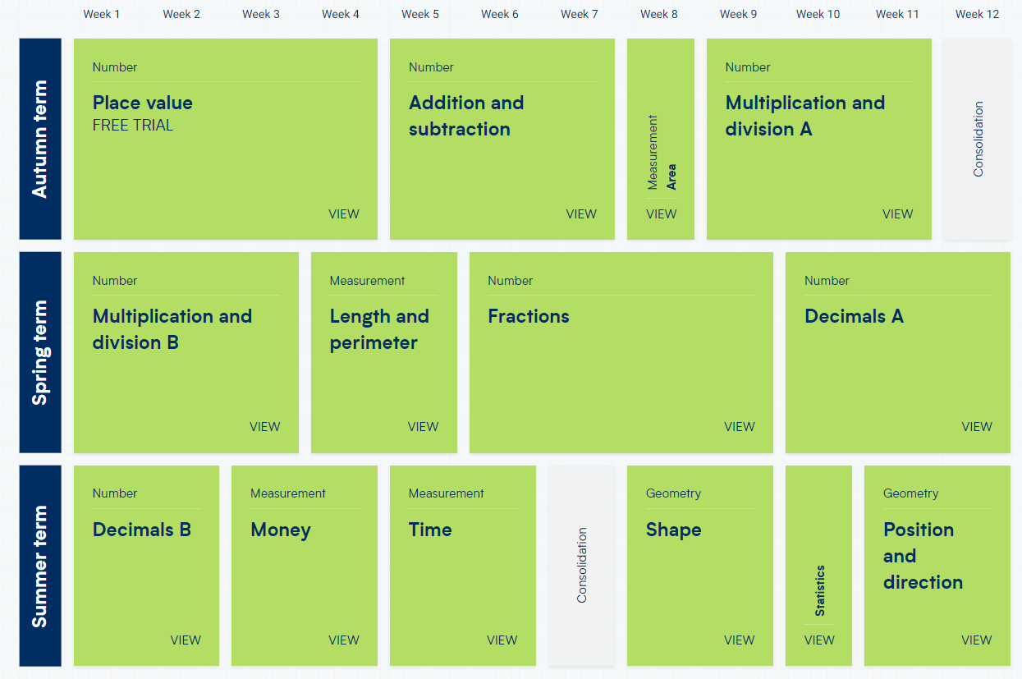
Our Maths Long Term Plan
Please help your children learn their tables by heart up to 12x12. Please ensure your Child practises their times tables by logging in to TT Rockstars for at least 20 minutes a week.
The children also need to know number bonds within 10, 20 and 100 and related facts:
4 + 6 = 10 7 + 8 = 15
40 + 60 = 100 70 + 80 = 150
400 + 600 = 1,000 700 + 800 = 1, 500 etc.

Slide 8
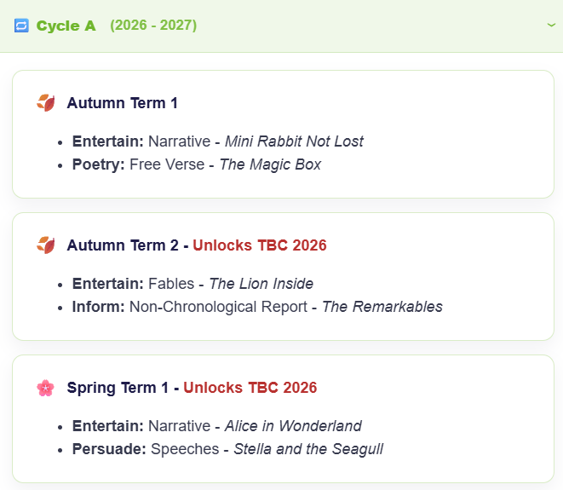
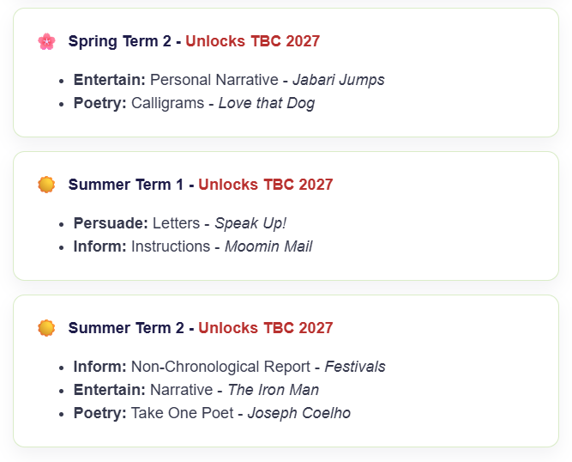
Our English Long-Term Plan

Slide 9

Children will be given 2/3 reading books each Friday. If they finish all 3 books before the next Friday, they can ask for a new one.
Children should bring their reading books and records in each day.
We will try to hear your child read as often as possible.
Please try to read at home with your child at least 4 times weekly. Please talk about the story and ask them questions to check their understanding.
Children will also take home a school library book once a week, which they can change during our library slot on a Wednesday.

Slide 10

Your child will bring home up to a maximum of 10 spellings each week to practise and learn.
Please help your child to learn their weekly spelling words ready for their test each Monday morning.
Using ‘look, cover, write’ or spelling out loud are good ways to practice. It might also be useful to ask your child to put each word into a sentence so they can use the word in context.

Slide 11
In Orca Class we encourage the children to work hard, have fun and always try their best!
If you have any further questions please feel free to contact the school office or Mrs Ainsworth.

