Slide 1

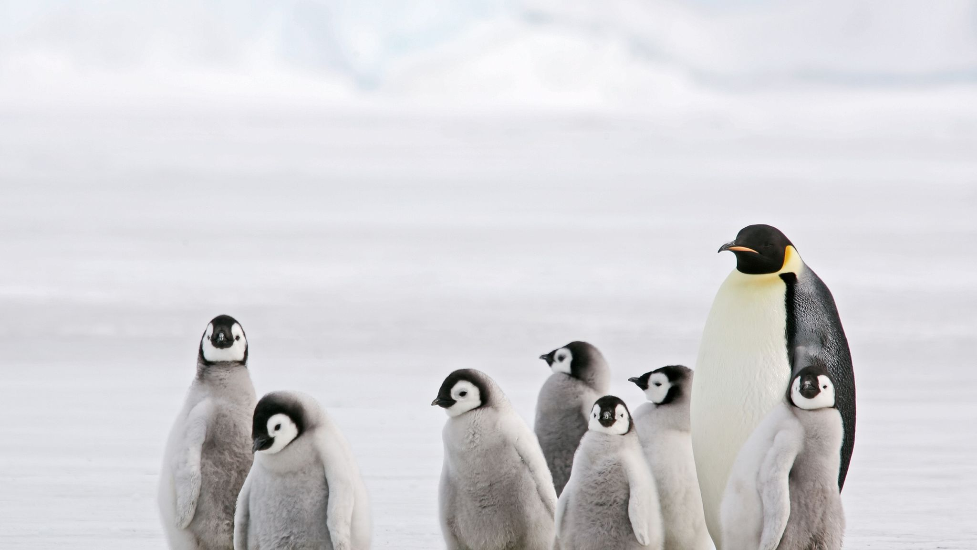
Welcome to Penguin Class
Year 2
This Photo by Unknown Author is licensed under CC BY-SA

Slide 2

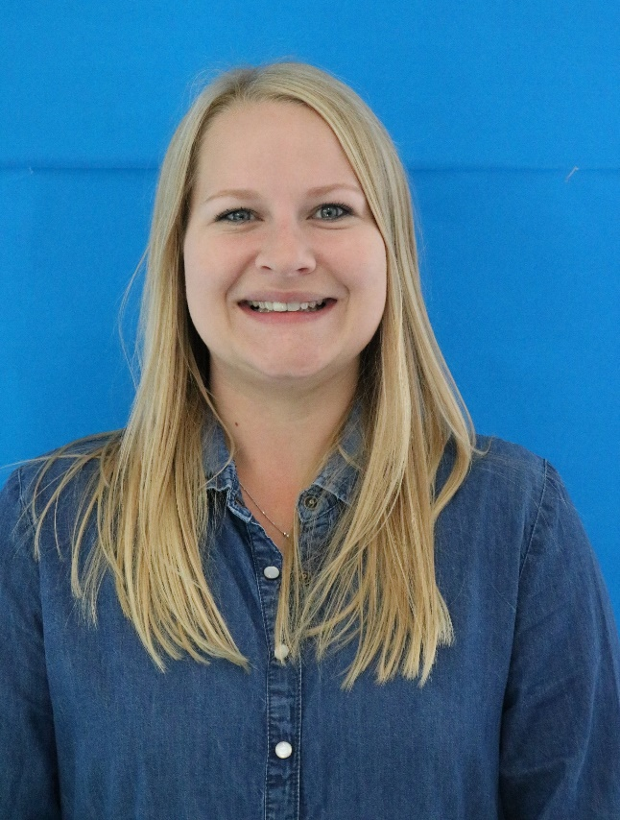
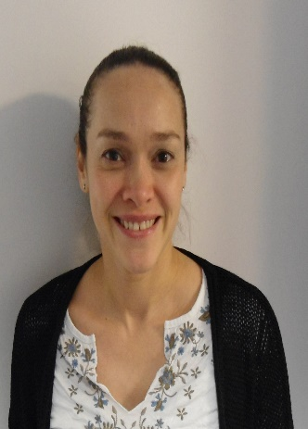
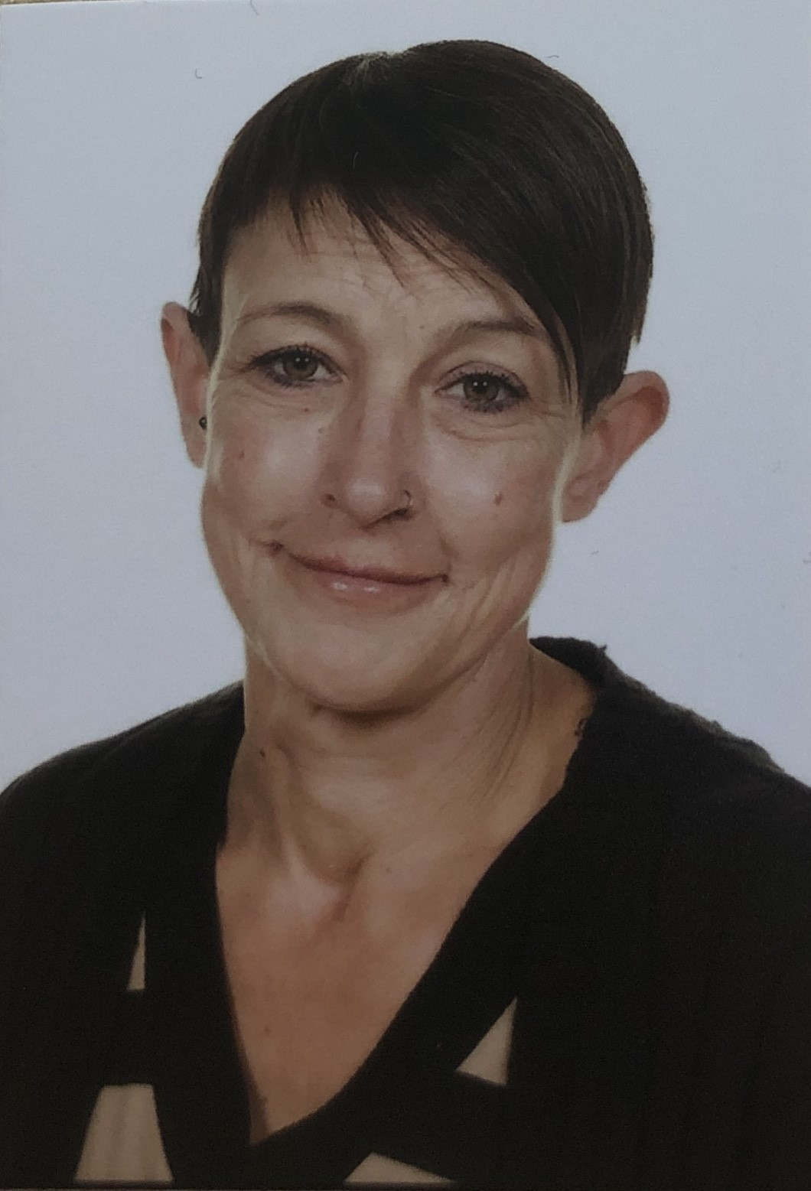
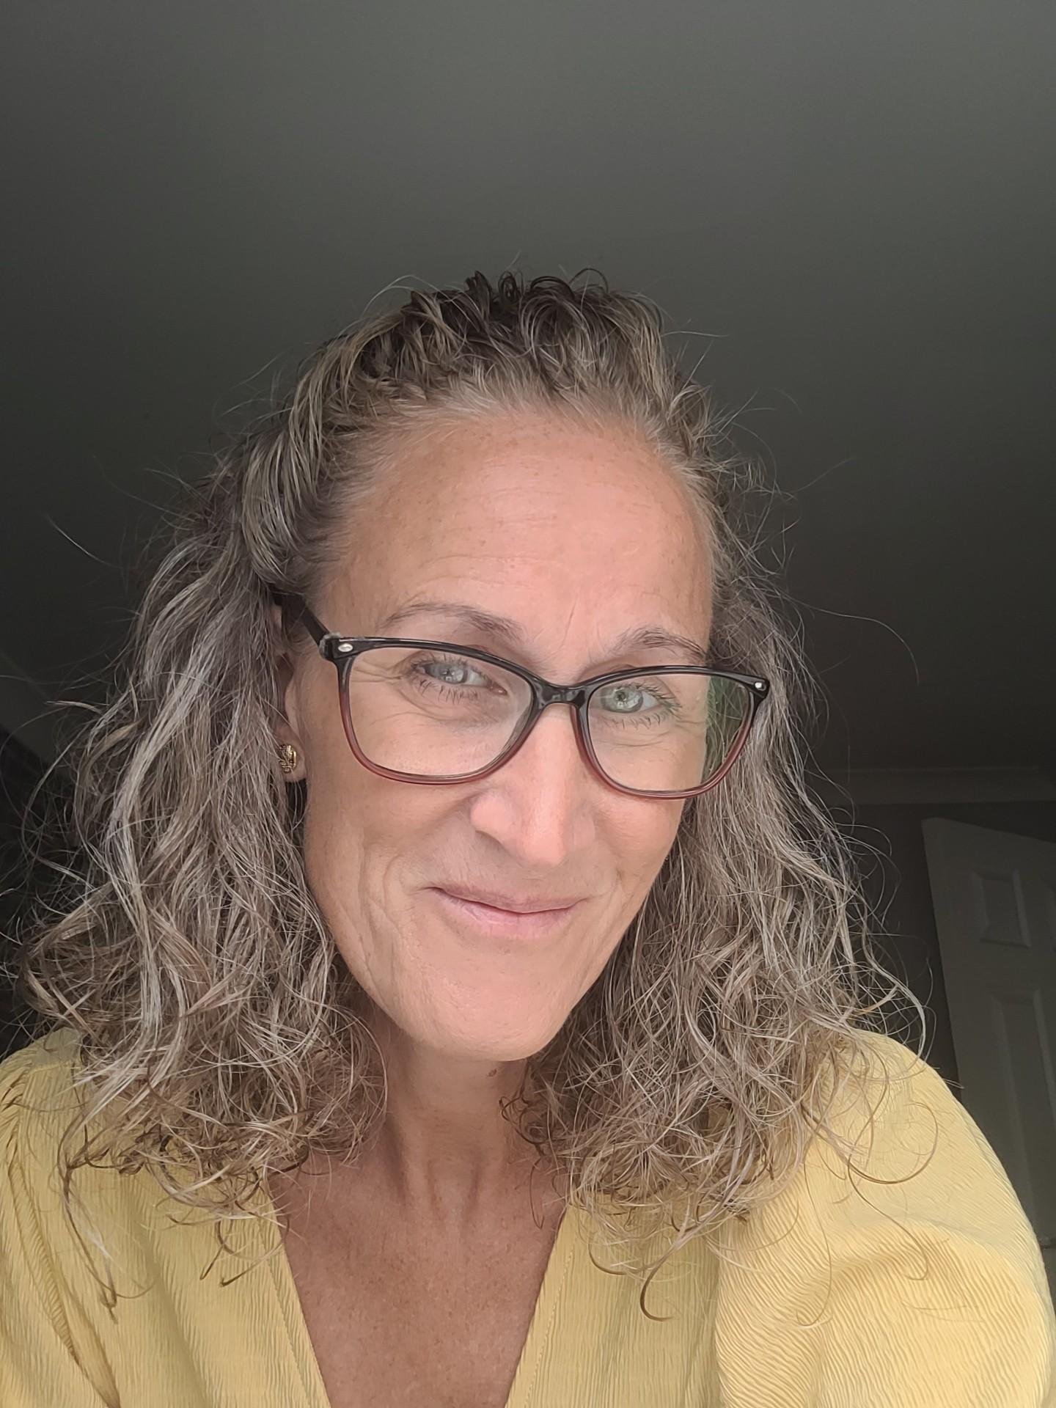
Who is in our classroom?
Miss Burley
Teacher
Miss Williams
Teacher
(Fridays)
Miss Young
Teaching assistant/LSA
Mrs Lugmayer
Teaching assistant/LSA

Slide 3
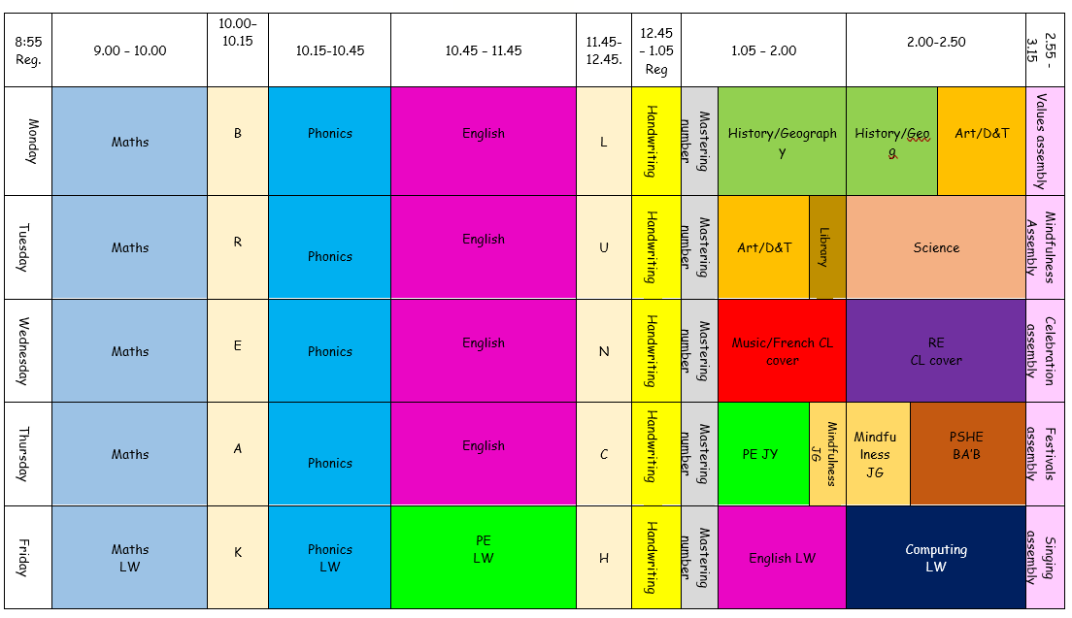
Timetable

Slide 4
Penguin Class Timetable
Pe - Thursdays and fridays
Library - tuesdays
Book change- thursdays

Slide 5
KS1 Routines
The gates will open at 8.45 and the registration starts at 9. Please enter the school through the gate, following the path to the playground. A member of staff will be at the gate to welcome the children and to send them straight to their classrooms. Please exit through the main gate and through the car park.
We will promote good hand hygiene throughout the day and the children will be encouraged to wash their hands on arrival at school, after outside breaks and of course before lunch and snack times. When possible we will keep the doors/ windows open and ensure the classrooms are well ventilated.
Our school day ends at 3.20pm. Please collect your children from their classrooms. The end of the day is a good time to pass on any quick messages or to ask your child’s class teacher any questions. However, for longer chats please book a time by emailing or ringing the school office.
Our morning timetable covers Phonics, English and Maths (with a break in between) and we break up for lunch at 11.45. School meals and packed lunches will be available for all KS1 children or if preferred the children can bring their packed lunches from home. The children are provided with a piece of fruit at break time. The children must bring a named drinks bottle to school on a daily basis (filled with water only). Please do not put water bottles in school bags, as we have had many reading books damaged because of leakages. We encourage the children to have regular drink breaks throughout the day.
Our afternoon sessions commence at 12.45pm and in the afternoons we get busy with History/Geography, Art/D&T, Science, Computing, RE, PSHE, Music and PE. For the Year 1 children the afternoons will be slightly less formal and some of the learning will occur through play. All the Key Stage 1 teachers will give their classes an afternoon break, should the children need it!
This year Mrs Beazley will be teaching forest school. Penguin Class is due to have their turn in the second half of autumn term.

Slide 6
Home reading and Phonics
Please read with your child as often as possible, ideally on a daily basis. Short regular sessions are better than reading the book in one go!
Please sign the reading record with the date and the page numbers as well as any relevant comments. Books will be changed on Fridays.
In phonics, the children are grouped based on their phonological awareness, they will bring home information about their focus phoneme (sound) and grapheme (how it is is written) every Friday in preparation for the following week. In addition to this they will bring home a grid containing some focus words reflecting the new knowledge that they will learning during phonics, for them to practise at home. We will teacher assess this every Friday during our phonics session, when the children implement all that they have learnt during the week.

Slide 7

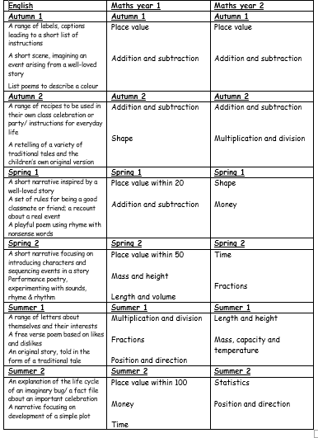
The following units of learning will be taught throughout the year.
Maths is a progressive subject; it will build upon previously taught units of work whilst extending and deepening the children’s understanding.
English also builds upon previous learning while at the same addressing the specific Year 2 objectives.
On the following slide, you will see the breakdown of the rest of the curriculum taught in KS1.

Slide 8

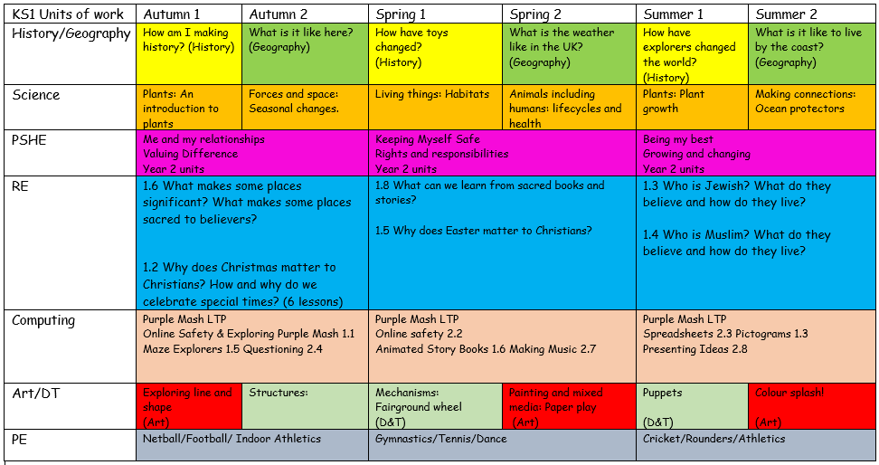

Slide 9
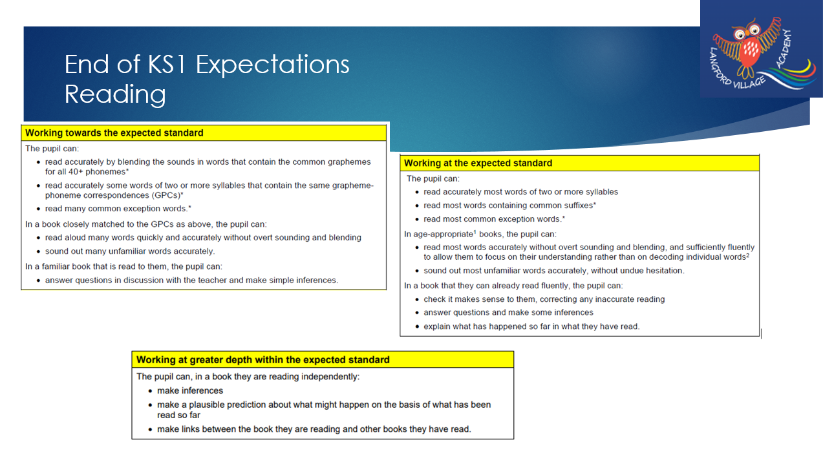

Slide 10
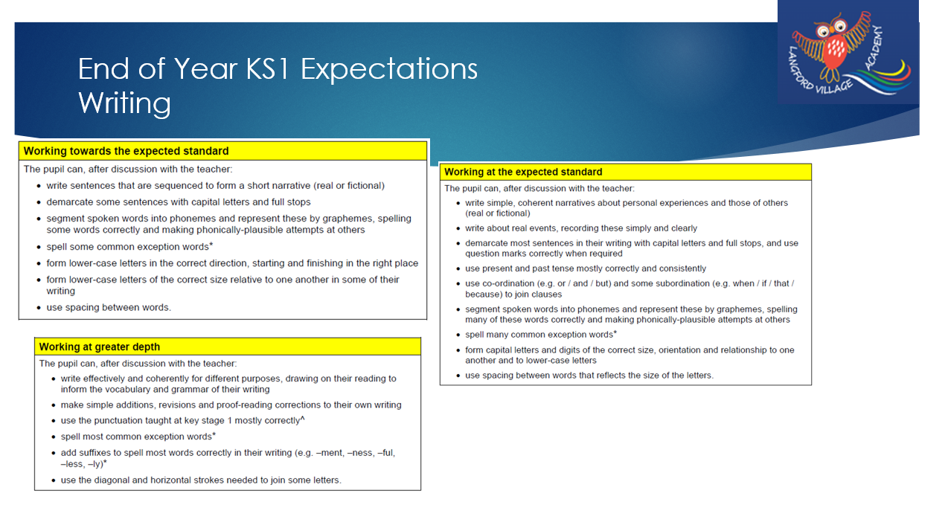

Slide 11
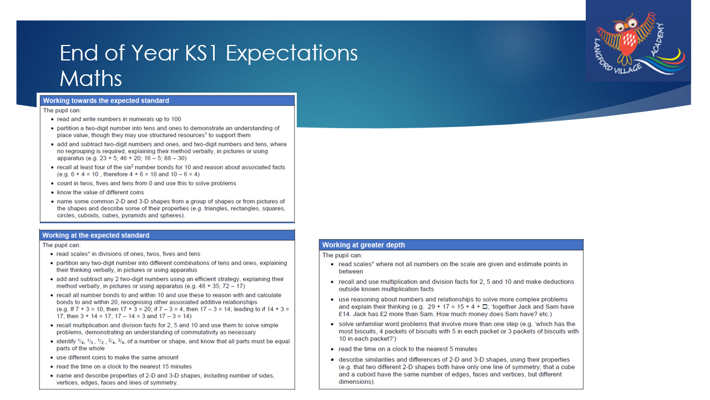

Slide 12
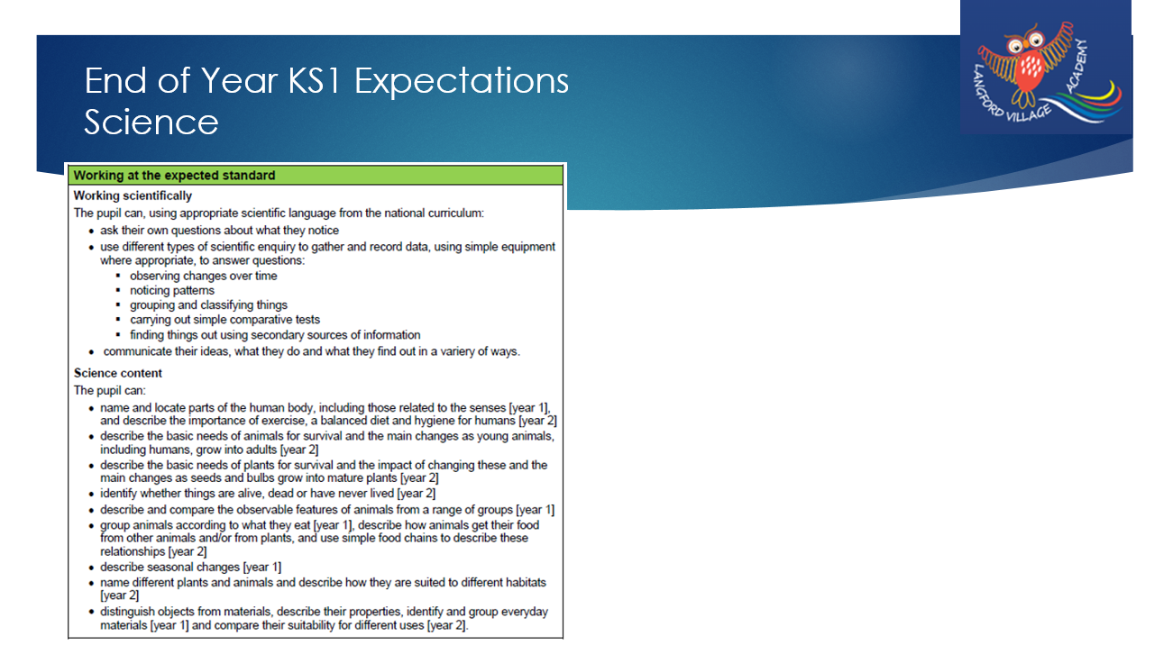

Slide 13
We look forward to welcoming your child into Penguin Class.
If you have any further questions please feel free to contact the school office or Miss Burley.

