Slide 1

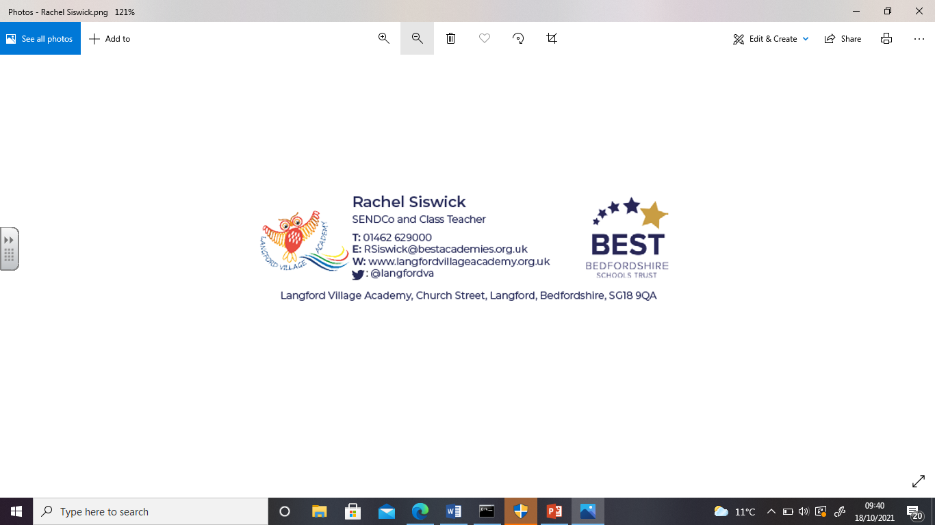
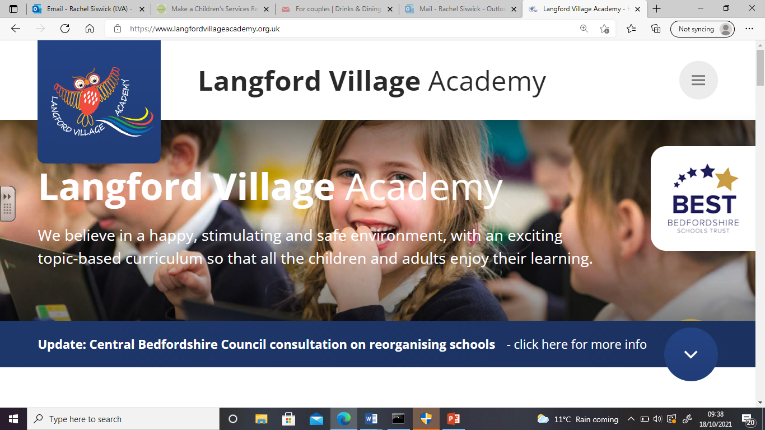
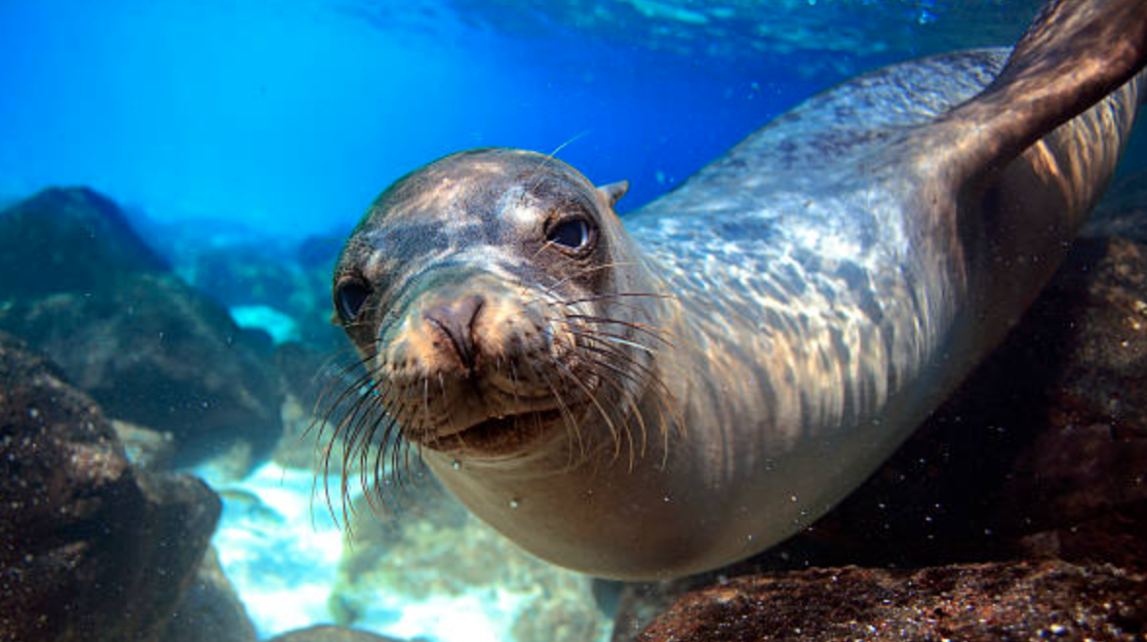
Welcome to Sea Lion Class
Langford Village Academy
Lower Key Stage 2
Year 3

Slide 2
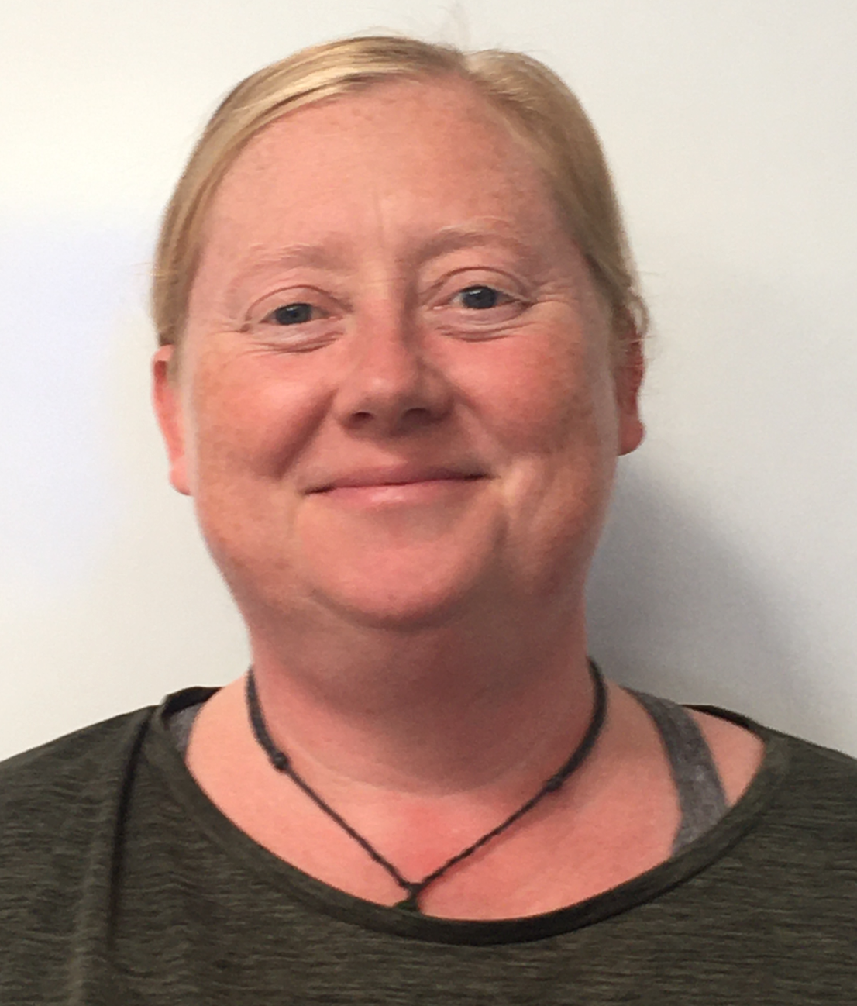
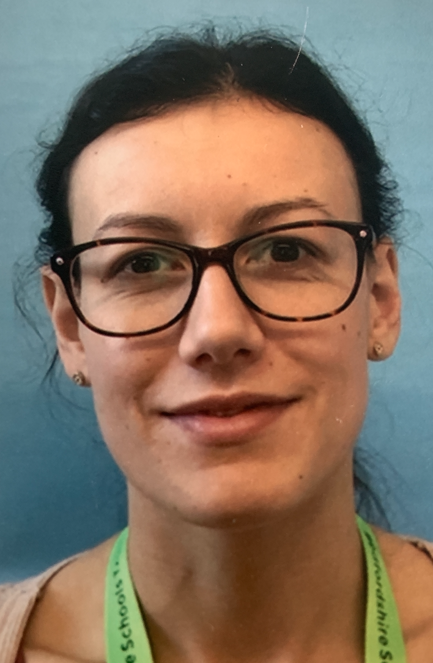
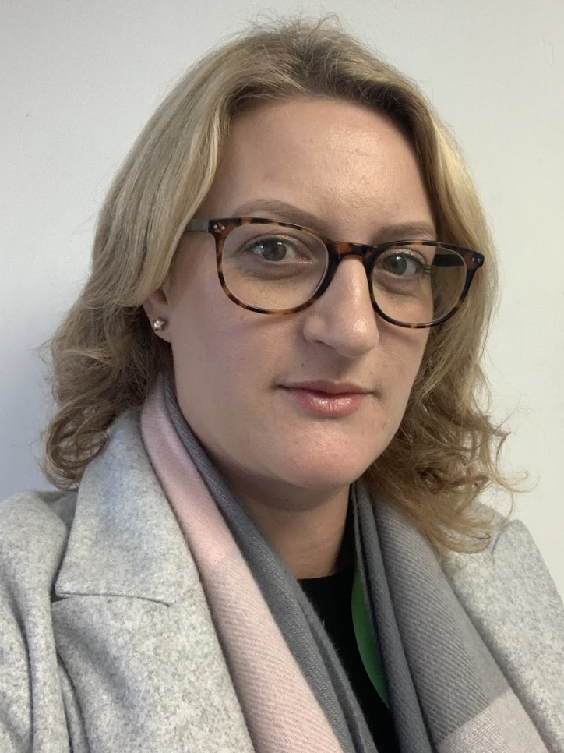
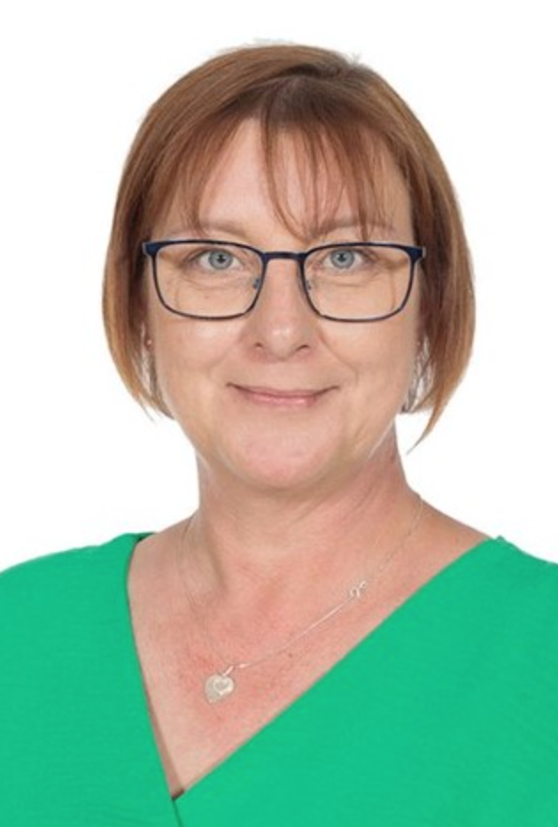
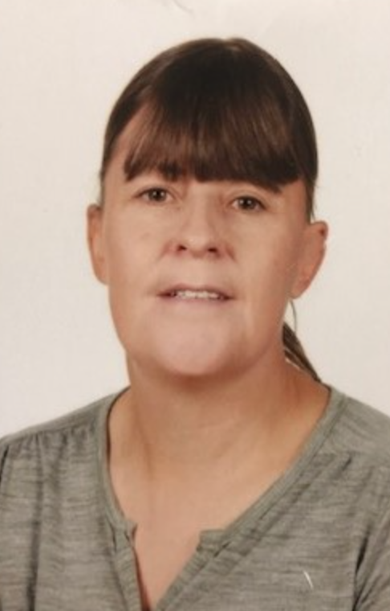
Who is in our Class?
Mrs. Jeffery
Teaching Assistant (Mon/Tues/Thurs)
Miss Rennie
Teaching Assistant
(Weds)
Mrs. Greenham
Teaching Assistant
(Fri)
Mrs. Whitton
Class Teacher
Mrs. Rowlands
PPA Cover (Weds PM)

Slide 3
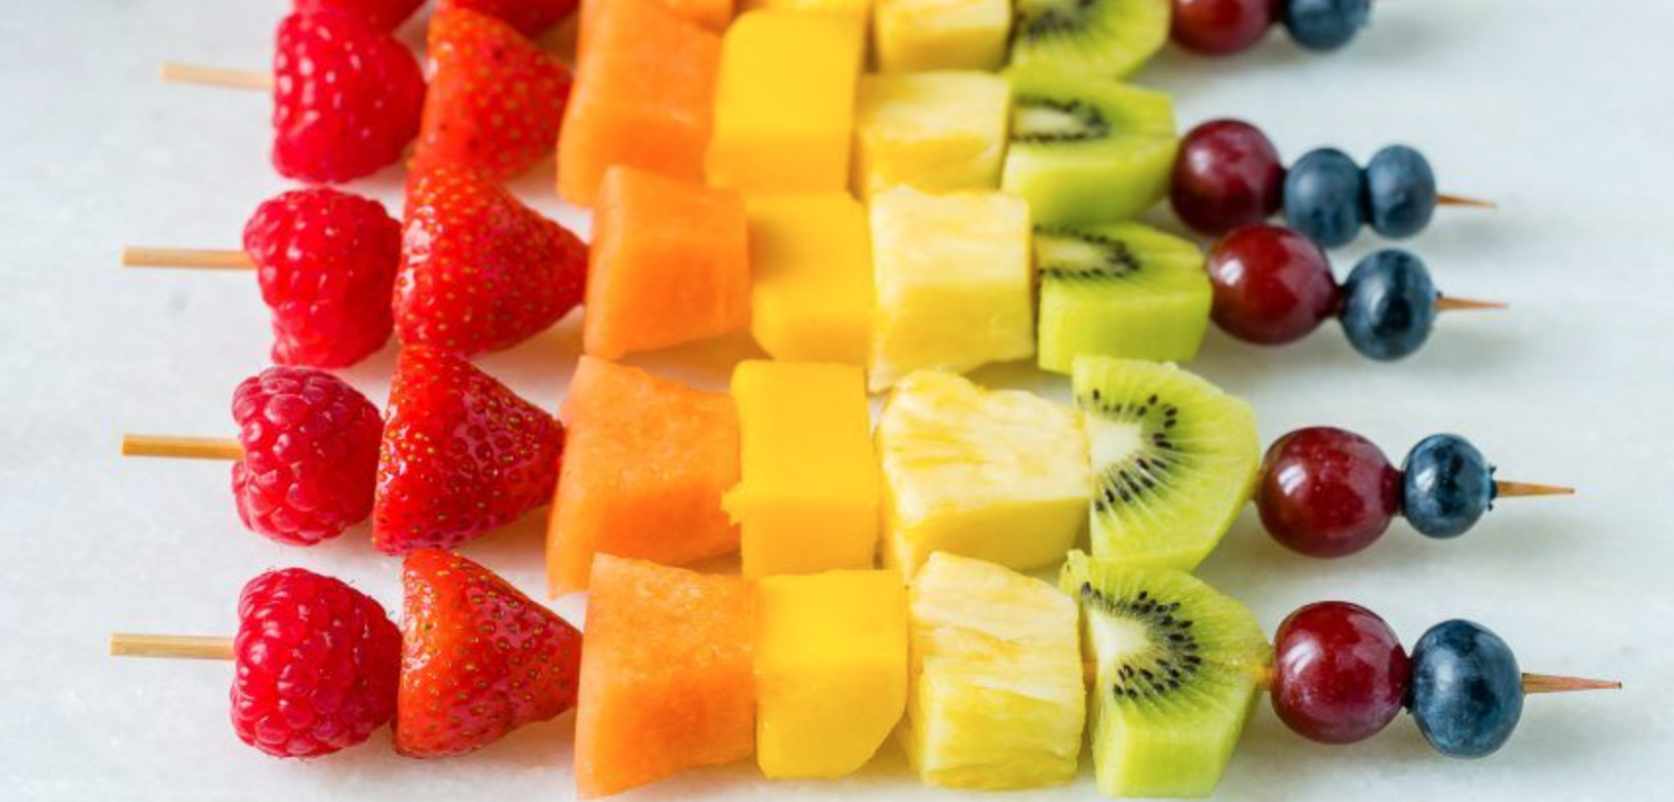
Morning Routine
Children should be dropped at the main gate at 8.50am where they will walk directly to their classroom, in time for registration at 8.55am.
Your child will need their book bag and a labelled water bottle.
They can bring a healthy snack for break time such as fruit, vegetables, rice cakes, etc.

Slide 4
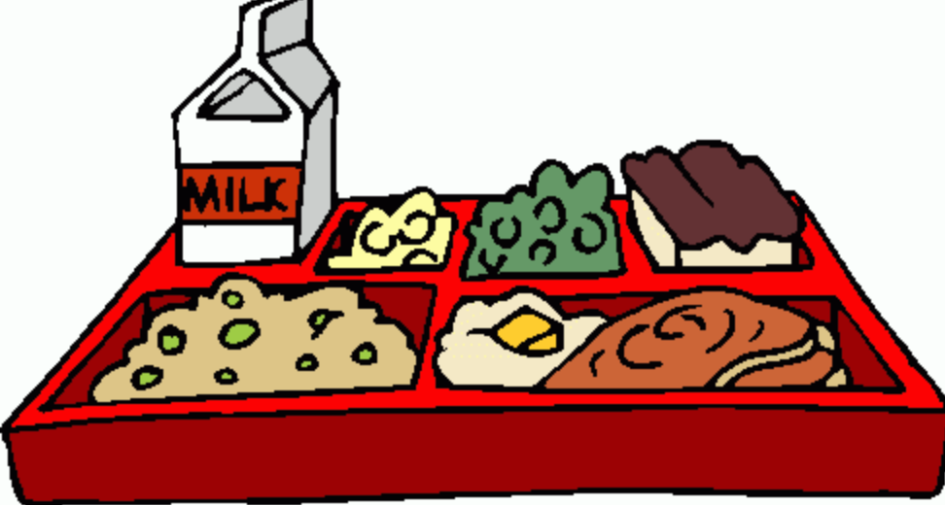
Lunchtime
Lunchtime begins at 12.15. Sea Lion class go outside to play until their class is called in for lunch. They then return to the playground until the end of lunchtime at 1.15pm.
The children return to their classroom for a drink before the afternoon session begins.

Slide 5
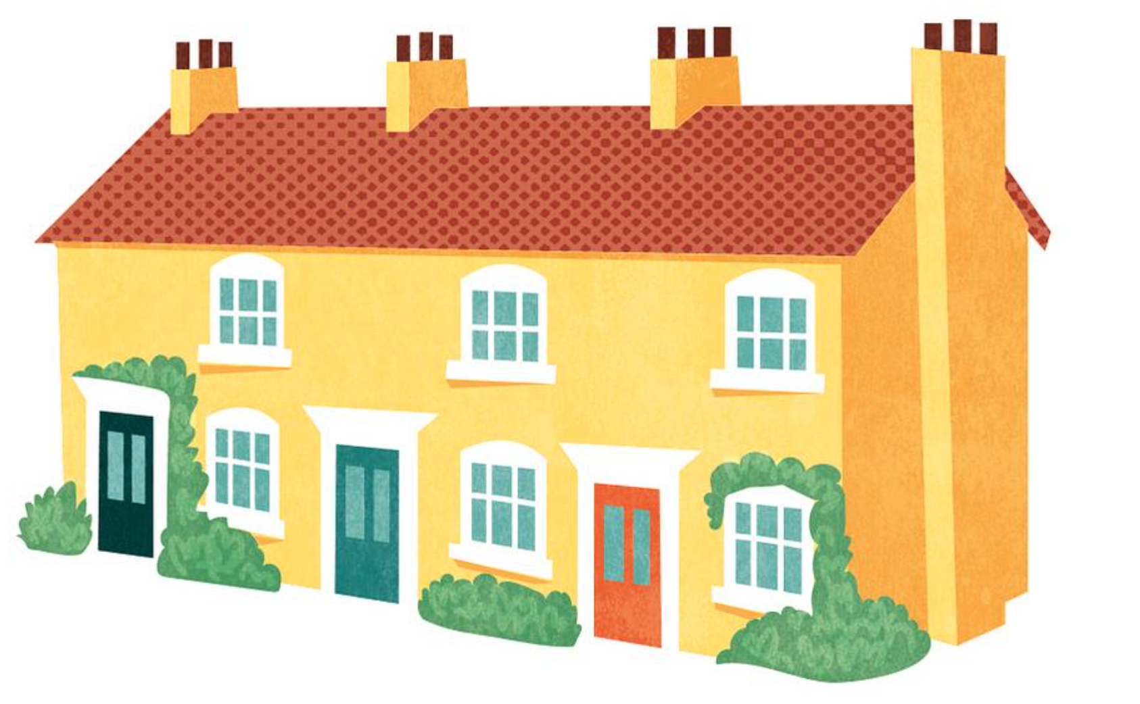
Afternoon Routine
The afternoon finishes with an assembly at 2.55, and the school day ends at 3:20pm.
The children are brought to the door underneath the canopy to be collected by their parents.
Your child can be collected when the parent or carer can be clearly seen.
If someone else is collecting your child, please let the school office know well in advance.

Slide 6
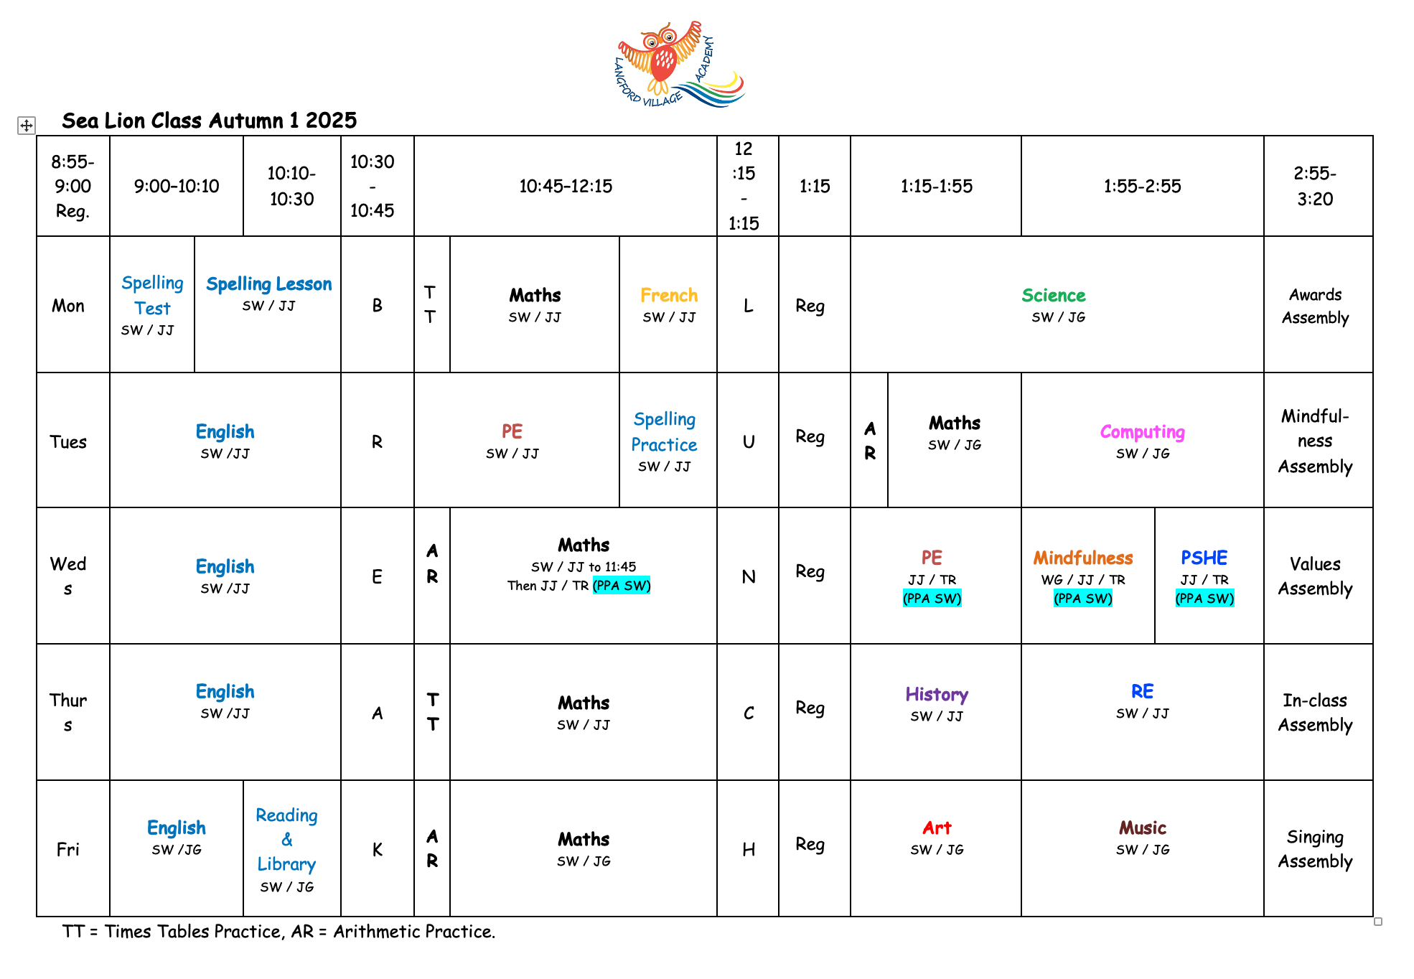
Autumn Term Timetable
Spelling Test Monday AM
PE Tuesday & Wednesday
Library on Friday

Slide 7
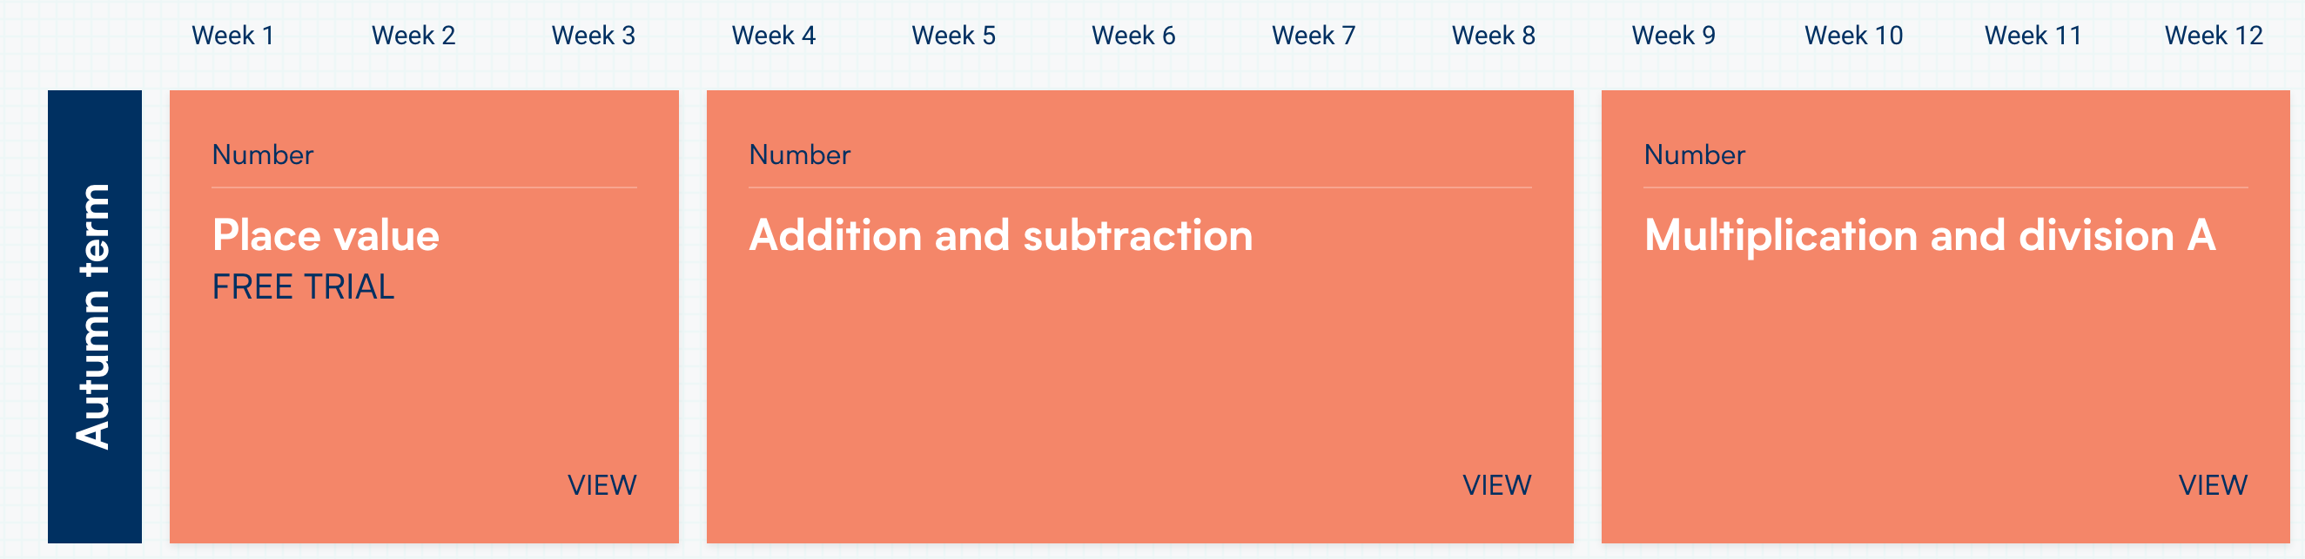
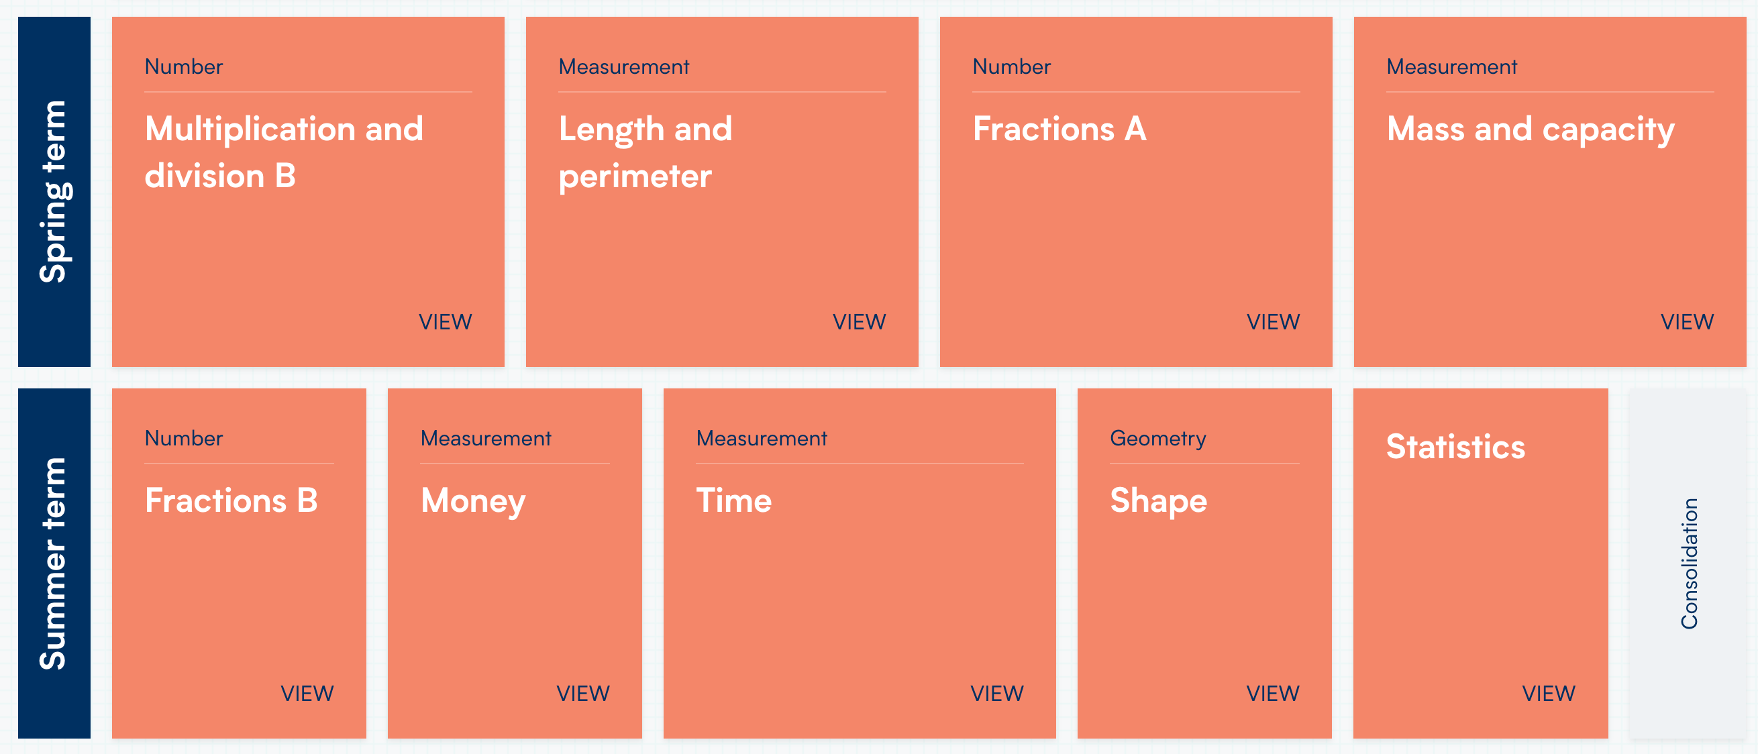
Our Maths Long Term Plan
Please help your children by helping them to learn their tables by heart up to 12x12.
The children also need to know number bonds within 10, 20 and 100 and related facts.
For example:
4 + 6 = 10
40 + 60 = 100
400 + 600 = 1,000
7 + 8 = 15
70 + 80 = 150
700 + 800 = 1, 500

Slide 8
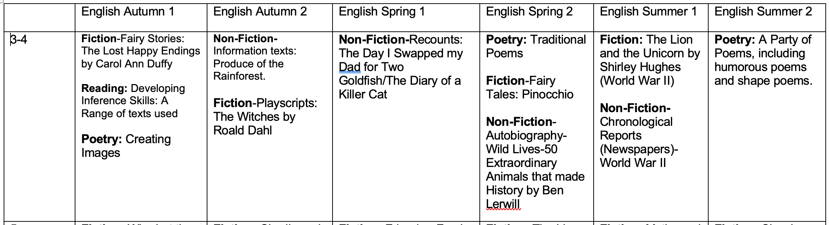
Our English Long-Term Plan

Slide 9

Reading
Children will be given 3 reading books each Friday. If they finish all 3 books before the next Friday, they can ask for a new one.
Children should bring their reading books and records in each day.
We will try to hear your child read as often as possible.
Please try to read at home with your child at least 4 times weekly. Please talk about the story and ask them questions to check their understanding.
Children will also take home a school library book once a week.

Slide 10

Spellings lessons are taught on Mondays. Your child will bring home up to 10 words per week from that lesson.
Please help your child to learn them over the week, ready for their test the following Monday morning.
Using ‘look, cover, write’ or spelling out loud are good ways to practice. It might also be useful to ask your child to put each word into a sentence so they can use the word in context.

Slide 11

We very much hope your child will enjoy their time in Sea Lion Class.
If you have any further questions, please feel free to contact the school office or Mrs Whitton.

