Slide 1
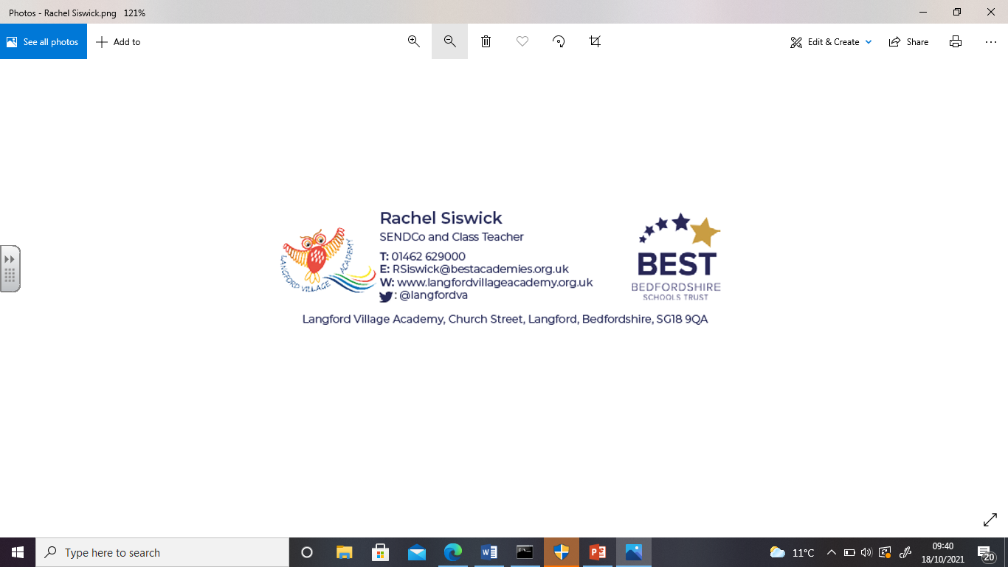
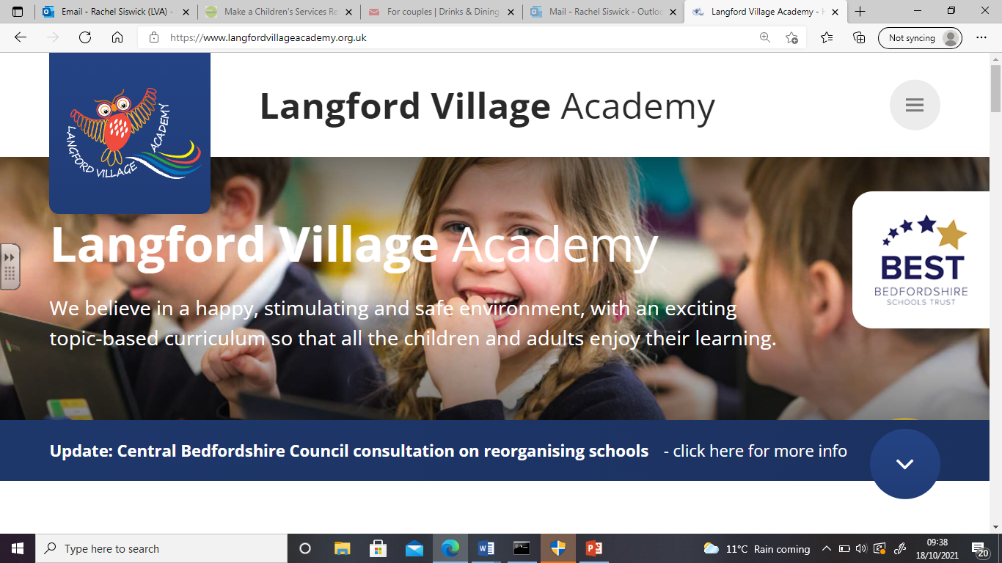
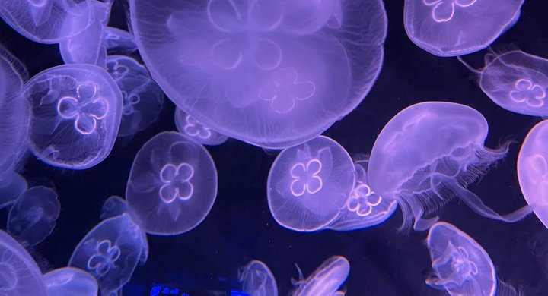
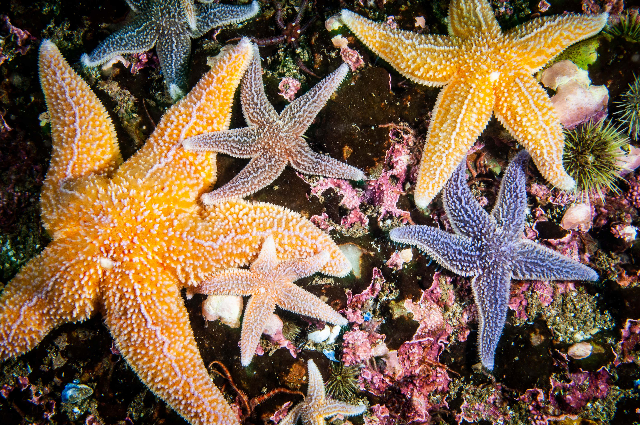
Welcome to Langford Village
Academy’s Foundation Stage
Jellyfish and Starfish Classes

Slide 2
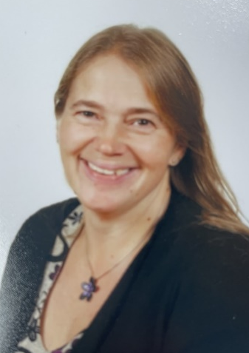
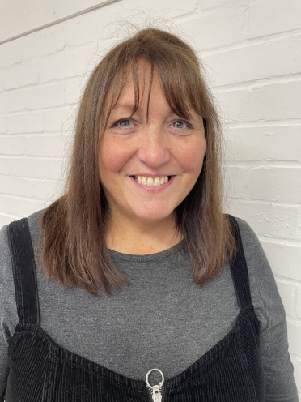
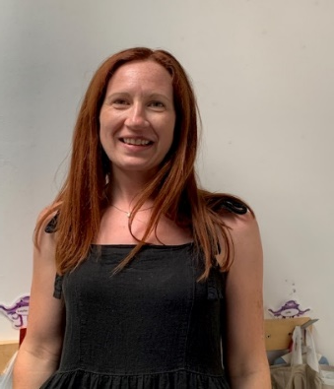
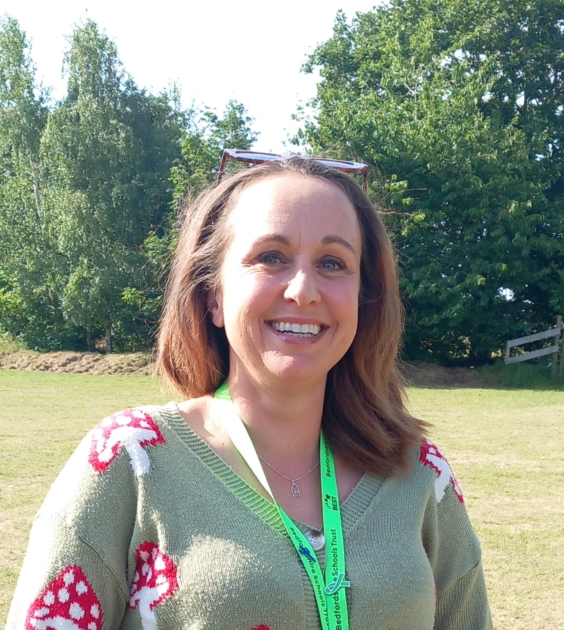
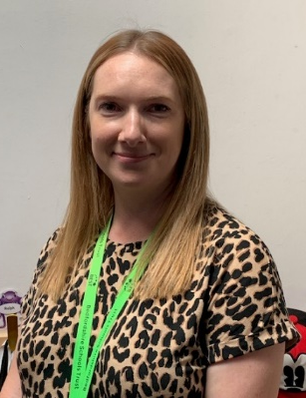
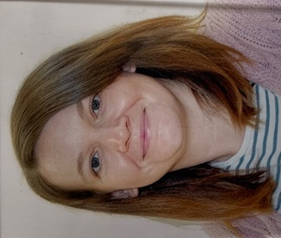
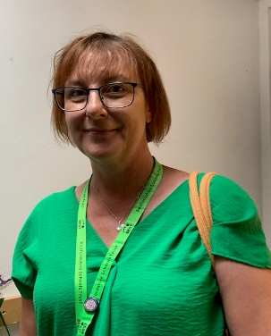
Who is in our classrooms?
Mrs Beazley
(Foundation Stage Leader)
Mrs Jones Mrs Murphy
Class Teacher Higher Level Teaching Assistant
Mrs McKay Mrs Baker Mrs Charge Ms Greenham
Teaching Assistant Teaching Assistant Early Years SEND Co Learning Support Assistant

Slide 3
A typical morning in the
Foundation Stage Classes
8.50 - Children arrive
8.55 - Registration
9.05 – Phonics and Writing
9.30 – Child initiated play and adult directed activities (indoors/outdoors)
10.30 – Milk and Snack time
10.50 – Maths
11.15 – Child initiated and adult directed activities
11.45 - Lunchtime

Slide 4
Lunchtime
Foundation Stage will have lunch between 11.45-1.00pm.
Your child is entitled to a free school lunch each day. This is a cooked meal.
If you would prefer, your child can bring in a packed lunch from home with them.

Slide 5
A typical afternoon in the
Foundation Stage Classes
1.00 – Afternoon registration
1.05 – Topic based activities
1.30 – Choosing activities
2.55 – Assembly/ Story time
3.15 – Home time

Slide 6
Forest School
The sessions are between 1 ½ and 2 hours long. This is to allow the learners time to relax and be able to let go of any stresses they are feeling as it takes on average 20 minutes to just ‘unwind’ from the day to day pressures they are feeling, the same as an adult.
What will be on offer in each session:
A new adult directed activity
Previous activity resources to enable their own investigations
Mud area
Stick resources for own play – den building etc
Scavenger hunt sheets
Time for their own play and exploring resources/ the environment

Slide 7
Foundation Stage
Topics
Throughout the year we cover 6 topics:
Autumn 1: Ourselves/All about me
Autumn 2: Festivals
Spring 1: Dinosaurs
Spring 2: Spring and Easter
Summer 1: Traditional Tales
Summer 2: Under the Sea

Slide 8
Areas of
Learning & Development in the EYFS
There are seven areas of learning and development that must shape educational programmes in early years settings. All areas of learning and development are important and inter-connected
Three areas are particularly important for building a foundation for igniting children’s curiosity and enthusiasm for learning, forming relationships and thriving. These are the prime areas:
• Communication and Language
• Physical Development
• Personal, Social and Emotional Development
We must also support children in four specific areas, through which the three prime areas are strengthened and applied. The specific areas are:
• Literacy
• Mathematics
• Understanding the World
• Expressive Arts and Design

Slide 9
Teaching Schemes used in the
EYFS
Twinkl Phonics – to say the sounds for all of the letters in the alphabet and at least 10 digraphs, learn to segment and blend words
Master the Curriculum - Number focus to 10 rather than 20 to ensure mastery and a deep understanding of numbers
To subitise – the ability to recognise how many objects in a group without counting them
Primary P.E Planning – used through the whole school. Our focus’ are: first P.E, enjoy a ball, dance, gymnastics, multi skills, tennis

