Slide 1


Welcome to Turtle Class
Year 1 and 2
This Photo by Unknown Author is licensed under CC BY-SA

Slide 2
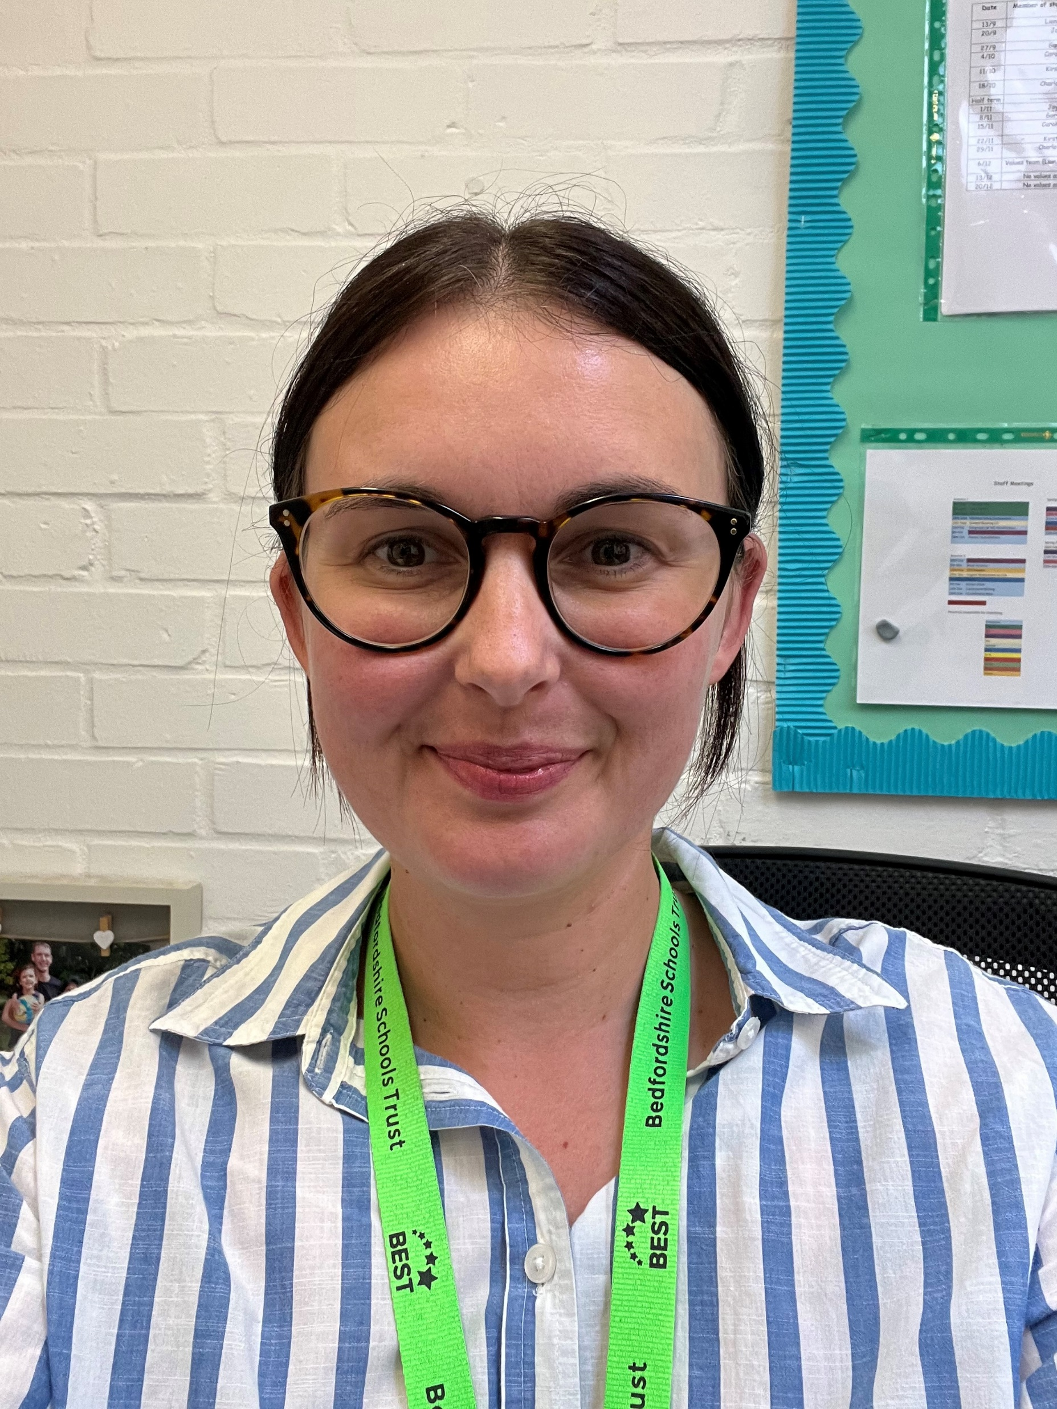



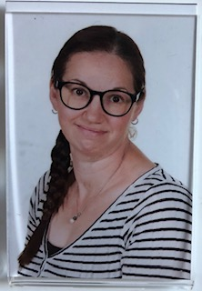
Who is in our classroom?
Mrs Parker
Teacher
Mrs Tarttelin
Teaching Assistant
Miss Lowe
Teaching Assistant

Slide 3

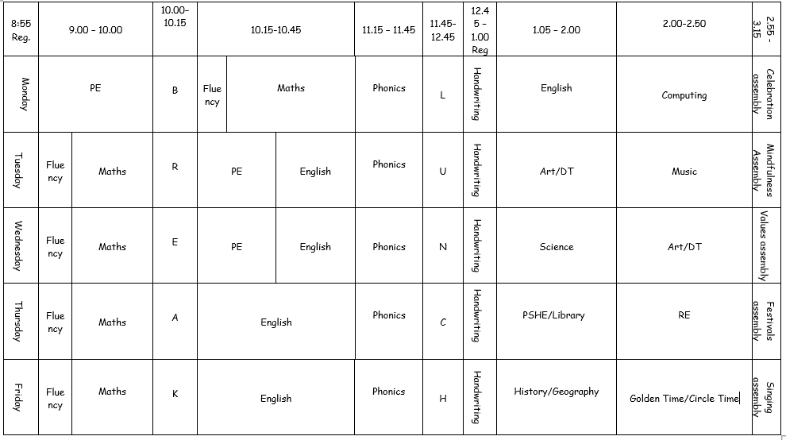
Timetable

Slide 4
Turtle Class Timetable
Pe – Monday, Tuesday, Wednesday
Library - Thursday
Book change- Friday

Slide 5
KS1 Routines
The gates will open at 8.45 and registration ends at 9.05. Please enter the school through the main car park, following the one-way system to the playground. A member of staff will be at the gate to welcome the children and send them straight to their classrooms.
Our school day ends at 3.20pm. Please collect your children from their classrooms. The end of the day is a good time to pass on any quick messages or to ask questions from your child’s class teacher. However, for longer chats please book a time by emailing or ringing the school office.
Our morning timetable covers Phonics, English and Maths (with a break in between) and we break for lunch at 11.45. School meals and packed lunches will be available for all KS1 children or if preferred the children can bring their packed lunches from home. The children are provided with a piece of fruit at break time. The children must bring a named drinks bottle to school on a daily basis (filled with water only). Please do not put water bottles in school bags, as we have had many reading books damaged because of leakages. We encourage the children to have regular drink breaks throughout the day.
Our afternoon sessions commence at 1pm and in the afternoons we get busy with Topic work, Science, Art, Computing, RE, PSHE and PE. For the Year 1 children the afternoons will be slightly less formal and some of the learning will occur through play. All the Key Stage 1 teachers will give their classes an afternoon break, should the children need it!

Slide 6

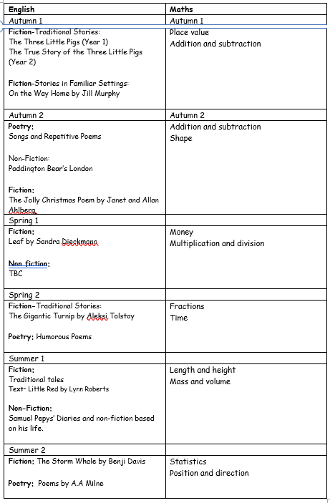
The following units of learning will be taught throughout the year.
Maths is a progressive subject; it will build upon previously taught units of work whilst extending and deepening the children’s understanding.
English also builds upon previous learning while at the same addressing the specific Year 2 objectives.
On the following slide, you will see the breakdown of the rest of the curriculum taught in KS1.

Slide 7

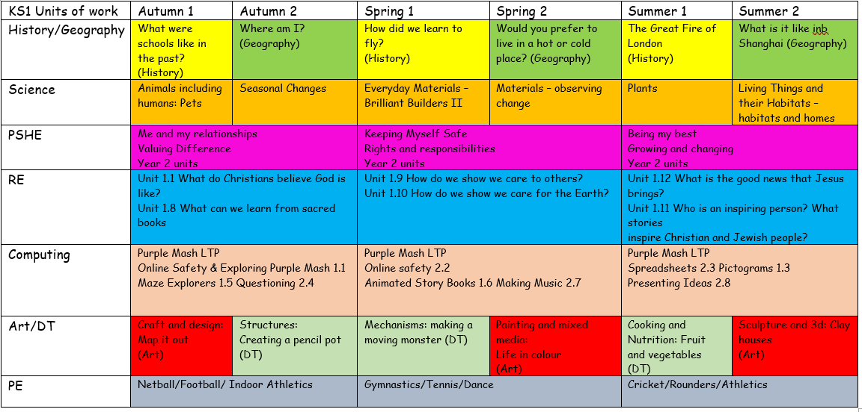

Slide 8

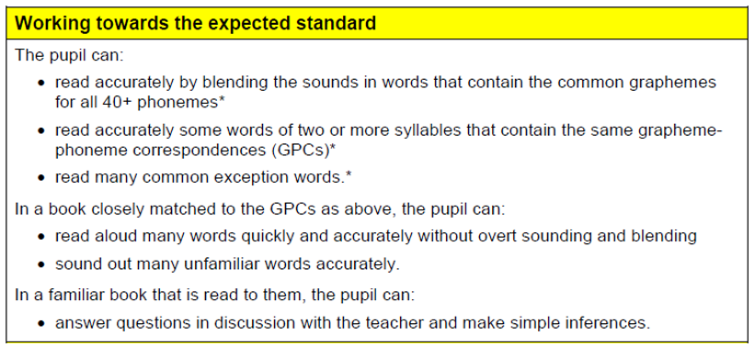
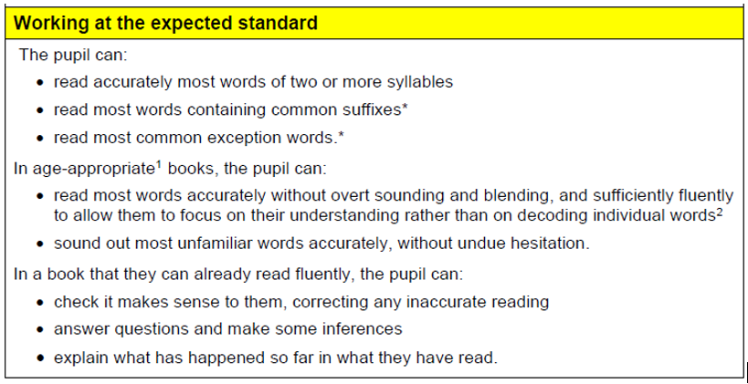
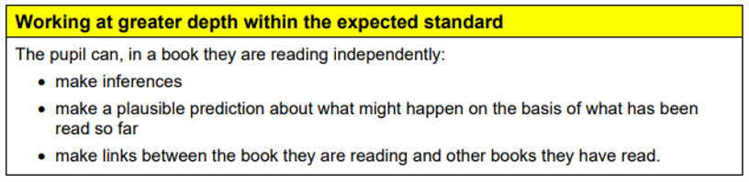
End of KS1 Expectations
Reading

Slide 9

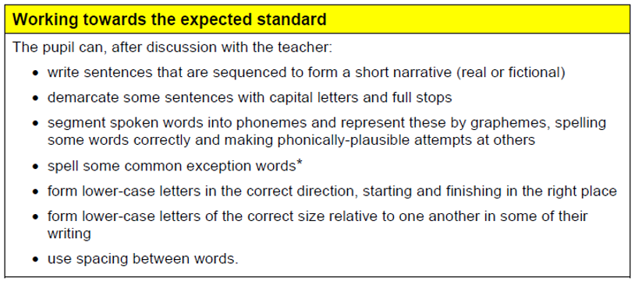
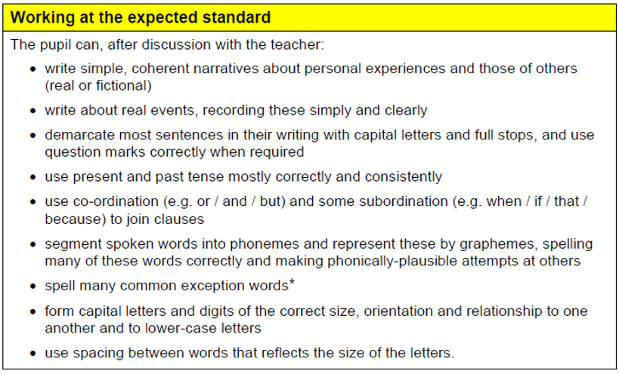
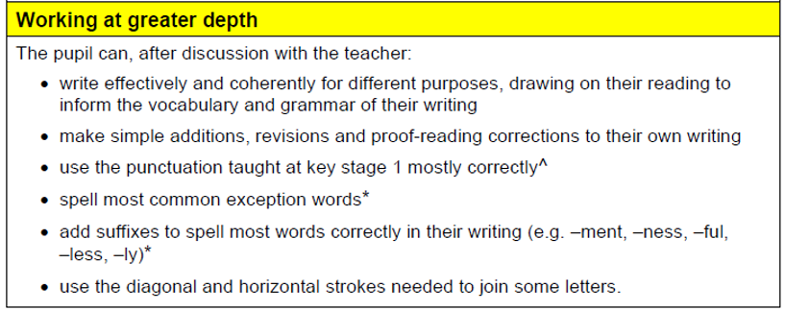
End of Year KS1 Expectations
Writing

Slide 10
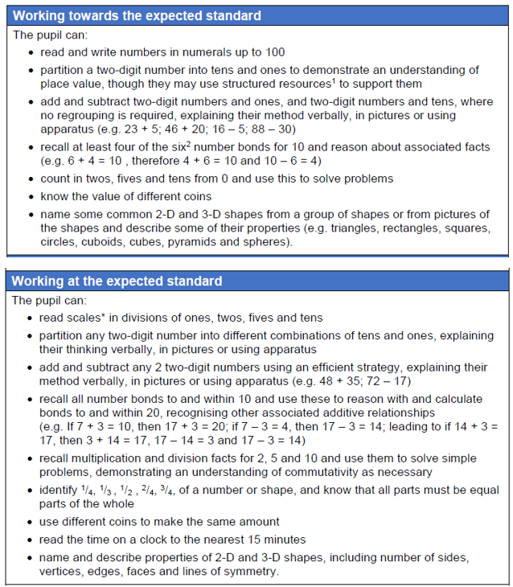
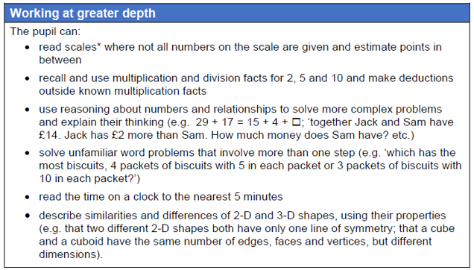
End of Year KS1 Expectations
Maths

Slide 11
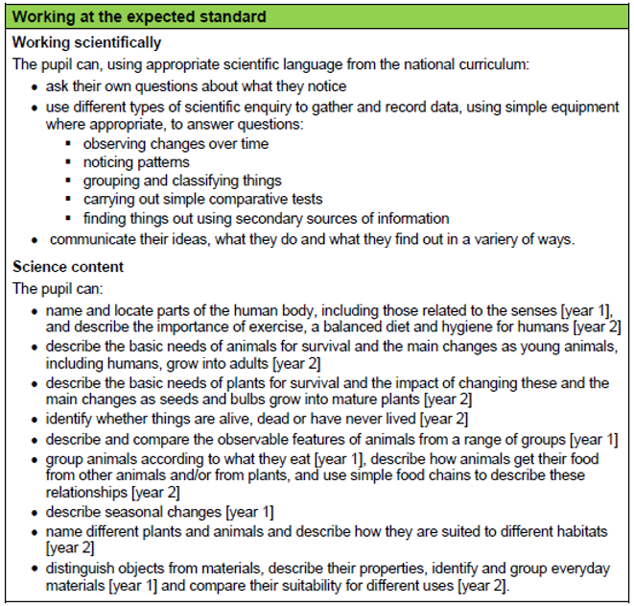
End of Year KS1 Expectations
Science

Slide 12
If you have any further questions please feel free to contact the school office or Mrs Parker.
We look forward to supporting your child with all of their learning!

