Slide 1


Welcome to Stingray Class
2025-2026

Slide 2
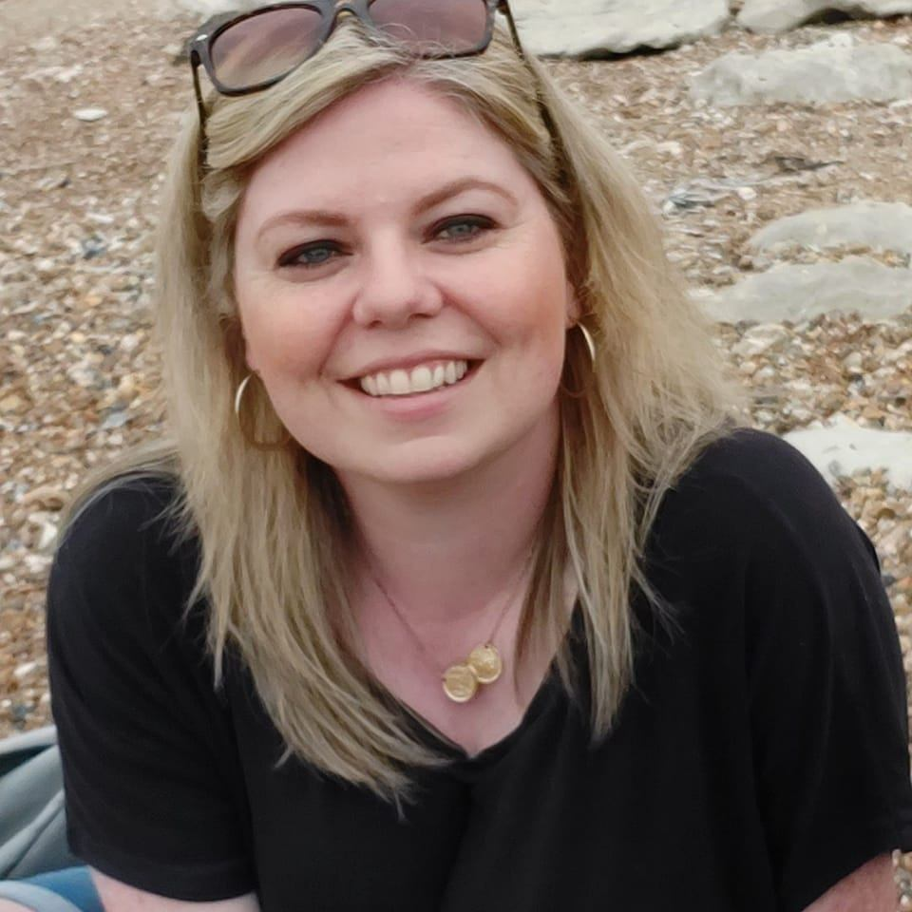
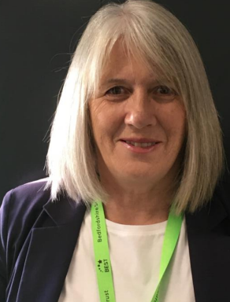
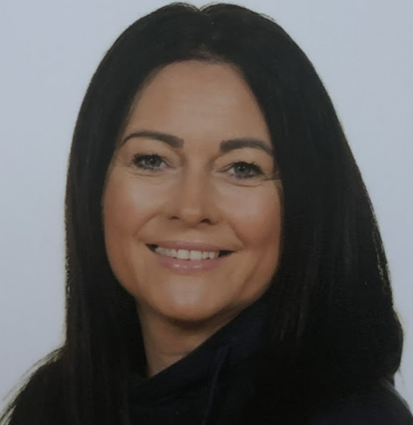
Who is in in our class?
Miss Harris
Class Teacher
Ms Devereux
Advanced TA
Mrs Fleming
LSA

Slide 3
Who is in in our class?
Mrs Shotter
LSA
Miss Crawford
LSA

Slide 4
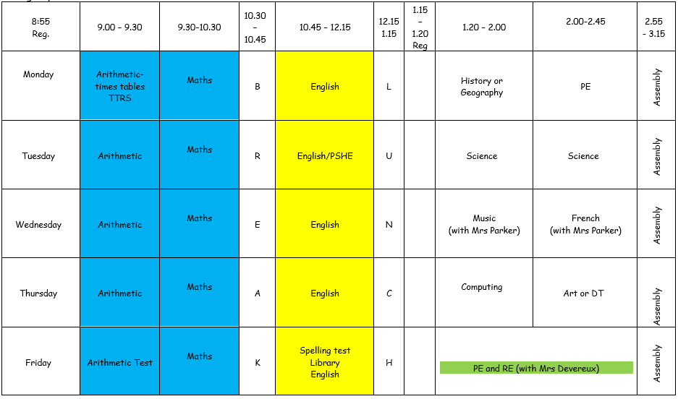
Our Timetable:
Notes:
Instead of having

Slide 5
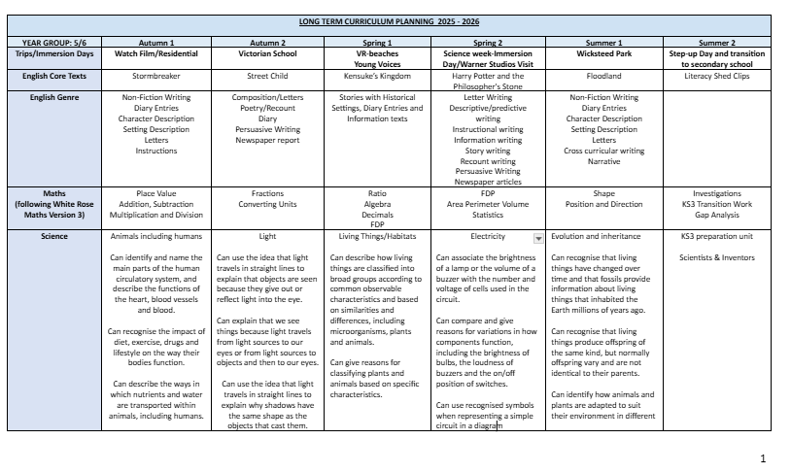
Curriculum overview:

Slide 6
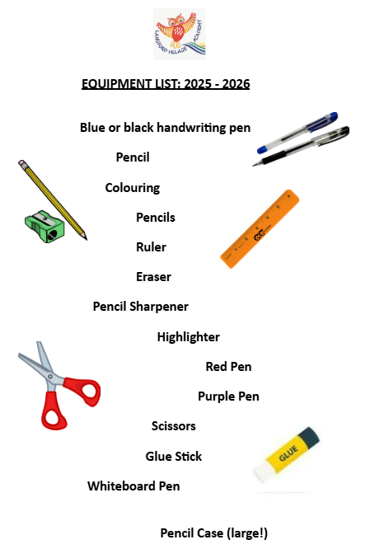
Equipment List:
In Year 5 and 6, our expectations are that the pupils bring in their equipment every day. This includes the items of stationery opposite, as well as their reading books and any PE wear they may need.
House points are awarded for correct equipment each week! ☺

Slide 7
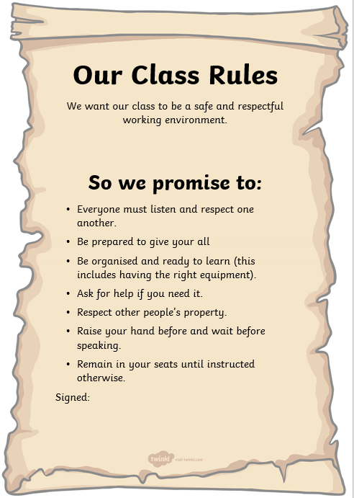
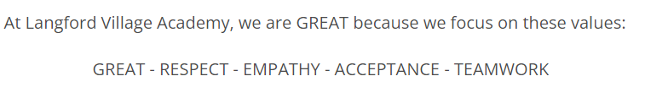
Our Class Promise:
In Stingray Class, we promise to be G.R.E.A.T and live by our school, and class rules. This means trying our best and respect each other.

Slide 8
Home Announcements:
Stingray Class PE: Monday and Friday
Reminders:
-Library books are changed on Fridays
-Reading books must be brought into school every day
-English and maths homework is set at the end of the week (Friday) and is due the following Wednesday
-Spelling test day: Friday (this is set on Mondays)
-TTRS can be accessed from home, and the expectation is that children should go on for 20 minutes a week.
*Each child has been given a BEST email address, which they can use to login Google Classroom. This is where our students will continue their educational journey throughout the year.

Slide 9
Parent Links:
English:
Pobble 365
https://pobble.com/
Once upon a picture
Maths:
TTRS
https://ttrockstars.com/
Maths is Fun
https://www.mathsisfun.com/
Mathsframe
https://mathsframe.co.uk/
Science:
Science Fun
https://www.sciencefun.org/kidszone/experiments/
Other:
Go Noodle
https://www.gonoodle.com/
BBC Bitesize

Slide 10

Are there any questions?
If you have any questions please contact the school office or Miss Harris.
My email address is nharris@bestacaedmies.org.uk
We look forward to supporting your child with all of their learning!

