Slide 1






DOLPHIN CLASS

Slide 2


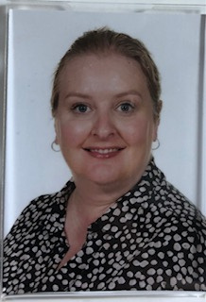
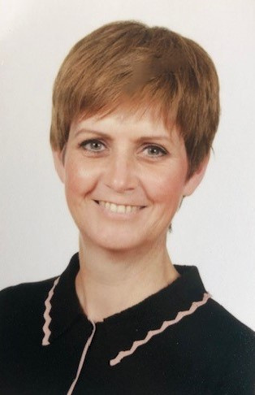
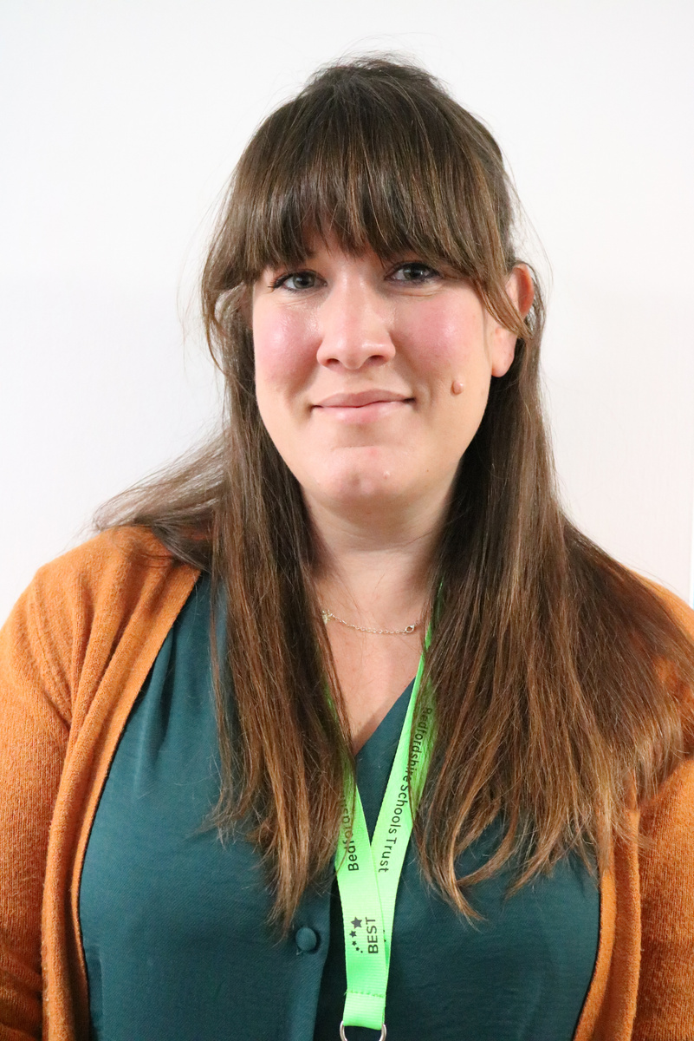
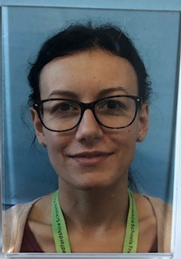
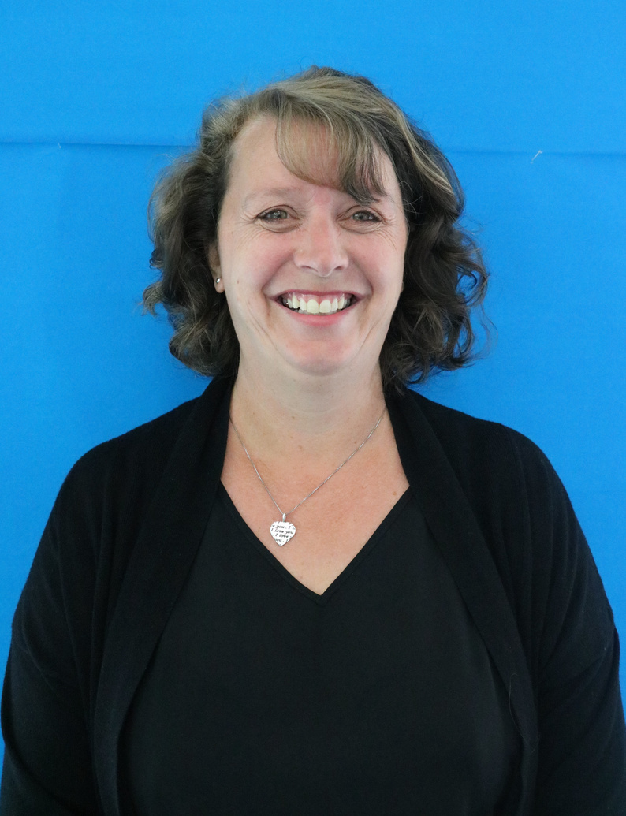
CLASS TEAM
Mrs Magee
Teacher
Mrs Parker
Teaching Assistant
Ms Moeller
Learning Support
Mrs Jeffrey
Teaching Assistant
Mrs Tartellin
Teaching
Assistant

Slide 3
MORNINGS
Children should be dropped at the main gate at 8.45am. They will walk directly to their classroom in time for registration.
Your child will need:
  book bag
  labelled water bottle
  fruit or vegetable snack for break time
  Waterproof coat/ jacket

Slide 4
LUNCHTIMES
Lunchtime begins at 12.15. Dolphin Class go outside to play until their class is called in for lunch. They then return to the playground until the end of lunchtime at 1.15pm.
The children return to their classroom for a drink before the afternoon session begins.

Slide 5
AFTERNOONS
Afternoons finish with an assembly at 2.55pm.
Children are brought to the main corridor side door and collected by their parents.
Your child can be collected when the parent or carer can be clearly seen.
If someone else is collecting your child, please let the school office know.

Slide 6
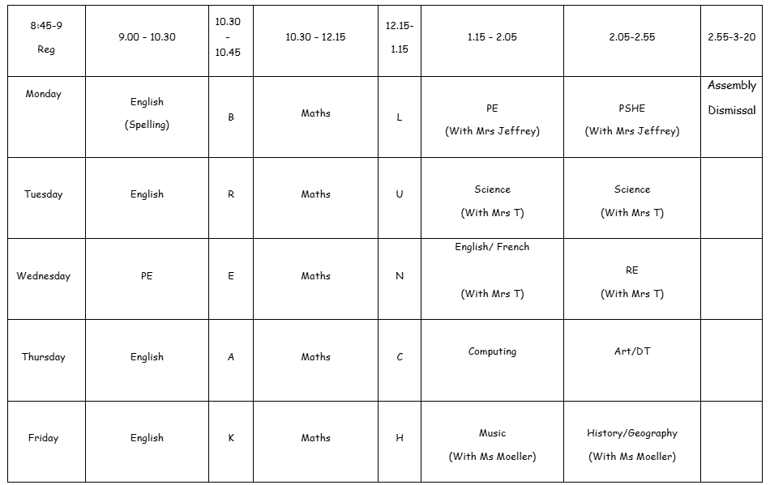
TIMETABLE

Slide 7



READING
Children will be given reading books each Friday.
Children should bring their reading books and records in each day.
We will try to hear your child read as often as possible.
Please try to read at home with your child at least 4 times weekly. Please talk about the story and ask them questions to check their understanding.
Children will also take home a school library book once a week.

Slide 8


PE
Our PE days are Mondays and Wednesdays.
For safety, all jewellery including earrings and watches must be removed.

Slide 9



SPELLINGS
Your child brings home up to 10 spellings per week. Please help your child to learn them ready for their test each Monday morning.
Spellings lessons are taught on Mondays.

Slide 10
We very much hope your child will enjoy their time in Dolphin Class.
If you have any further questions, please feel free to contact the school office or Mrs Magee.

